Slide 1
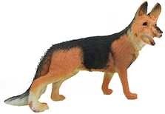
Dash, Watch Out for Rover
Challenge: Drive Dash as close as you can to the dog without hitting him.
Supplies: Tape measure and masking tape to mark your starting point.
Team Name: The most clever name will be used for tie breaking.
Code: Your program can only use the following drive function.
dash.forward_time(5)
Judging: When your group is ready, the judge will place the pooch in the road at a random distance from Dash. You may not move the mutt or Dash once the pet is placed. You may only change the value of time in the Dash drive statement. Competition distance between bowser and the Dash will be reported in cm. Don’t hit the hound!
Enter number of seconds to drive Dash forward.

Slide 2
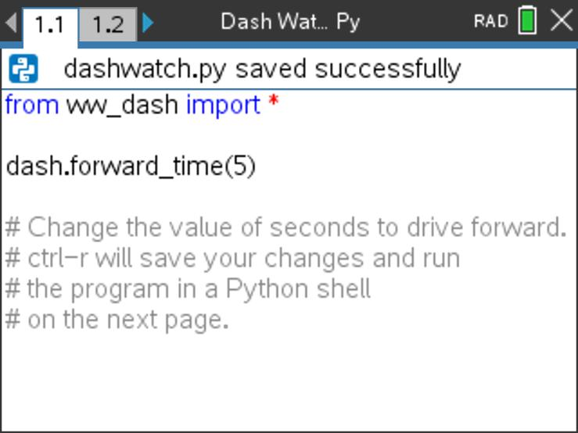
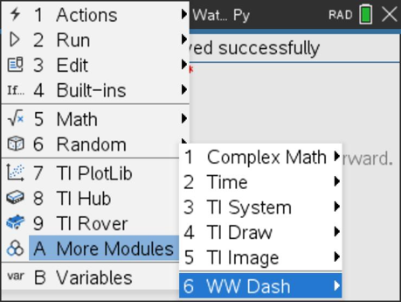
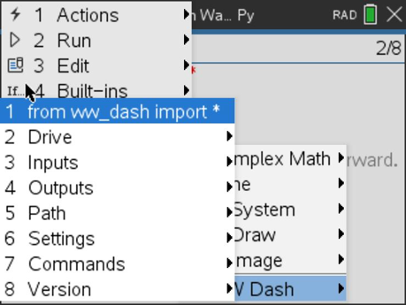
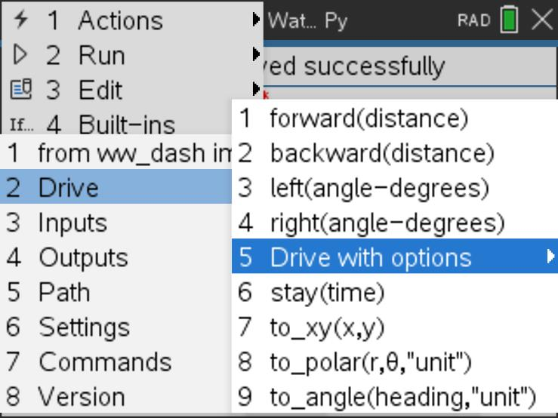
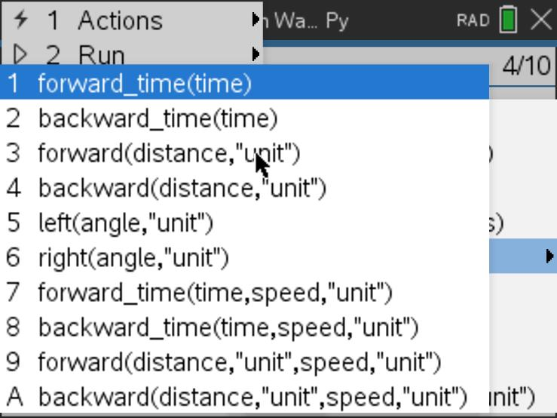
Watch out for Rover Program
from ww_dash import *
is available from the [menu]
A: More Modules
then WW Dash menu
1: from ww_dash import *
dash.forward_time( )
is available from the WW Dash 2: Drive
5:Dash Drive with options menu.
Select item 1:forward_time( )

