Slide 1
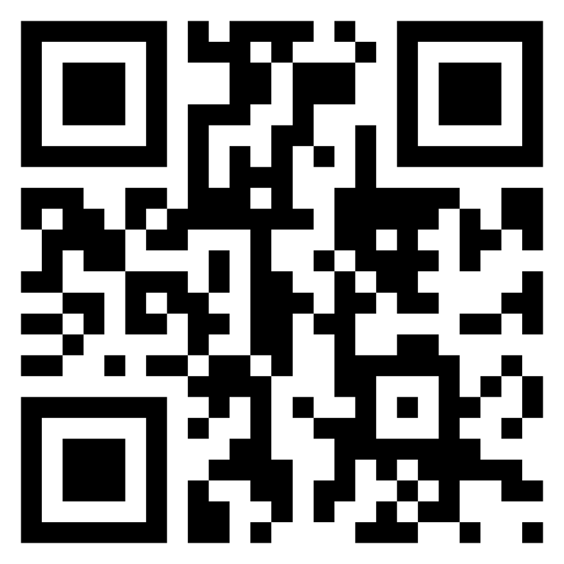
Meet TI-Rover Geometry Challenges Day TI-84 Plus CE Python
Texas Instruments
@ticalculators
www.TIstemProjects.com
Contact stem-team@ti.com with questions

Slide 2
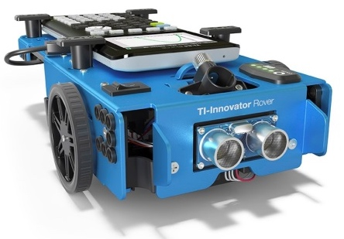
Meet the TI-Innovator™ Rover

Slide 3
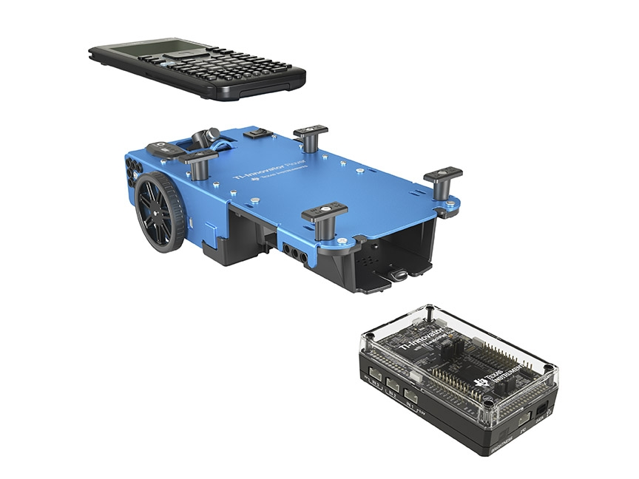
TI Graphing Calculator
TI-Innovator™ Rover
TI-Innovator™ Hub

Slide 4
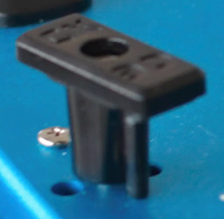
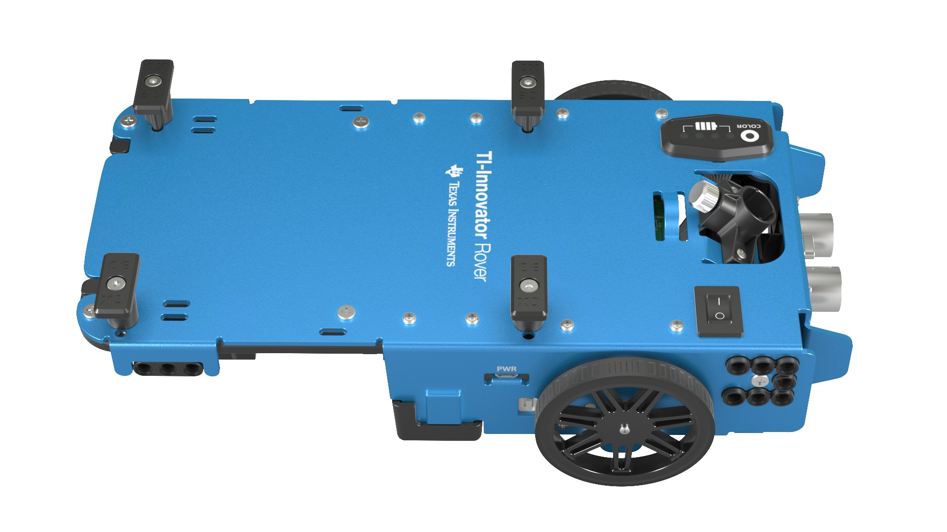
Rover from the top
Calculator holder posts.
Lift and twist to CE or CX side.
Red-Green-Blue (RGB) Color LED
Battery indicator
Marker holder
(Expo Fine and
Ultra Fine sizes)
Battery Charge with USB micro to wall adapter.
On/Off Switch

Slide 5
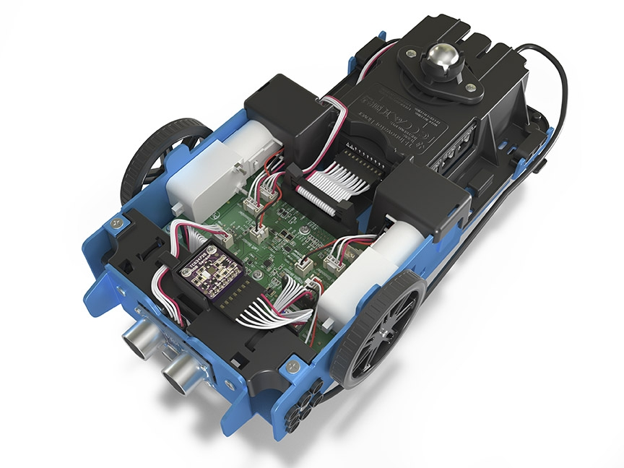
Turn Rover Over
What do you see?

Slide 6
Sensors on Rover
Motors to turn the wheels
Color sensor to detect different colors
Ranger to measure distance

Slide 7
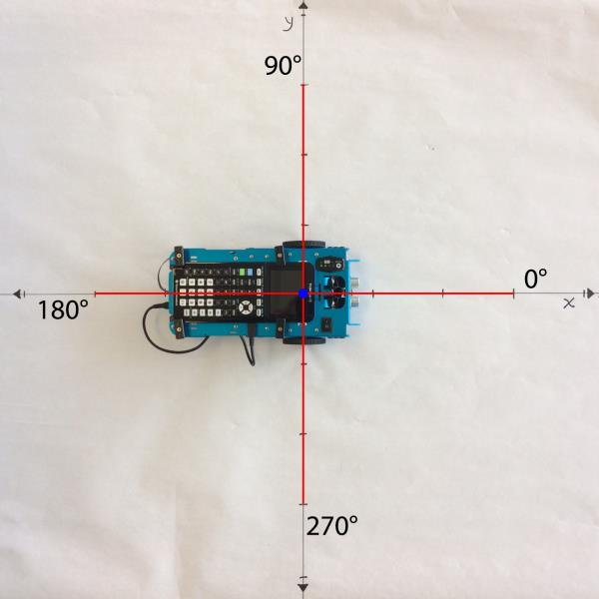
TI-Rover orientation and virtual grid
Rover programs set the initial position as the origin and the heading as 0 degrees measured from the x-axis.
Note: The Rover tracks its position on a virtual coordinate grid with a unit value of 10 cm. The coordinate grid position applies to the to_xy(x,y), to_polar(r,theta_degrees) and to_angle(angle, “unit”) functions on the Rover Drive menu. The virtual grid also applies to Path menu functions.

Slide 8
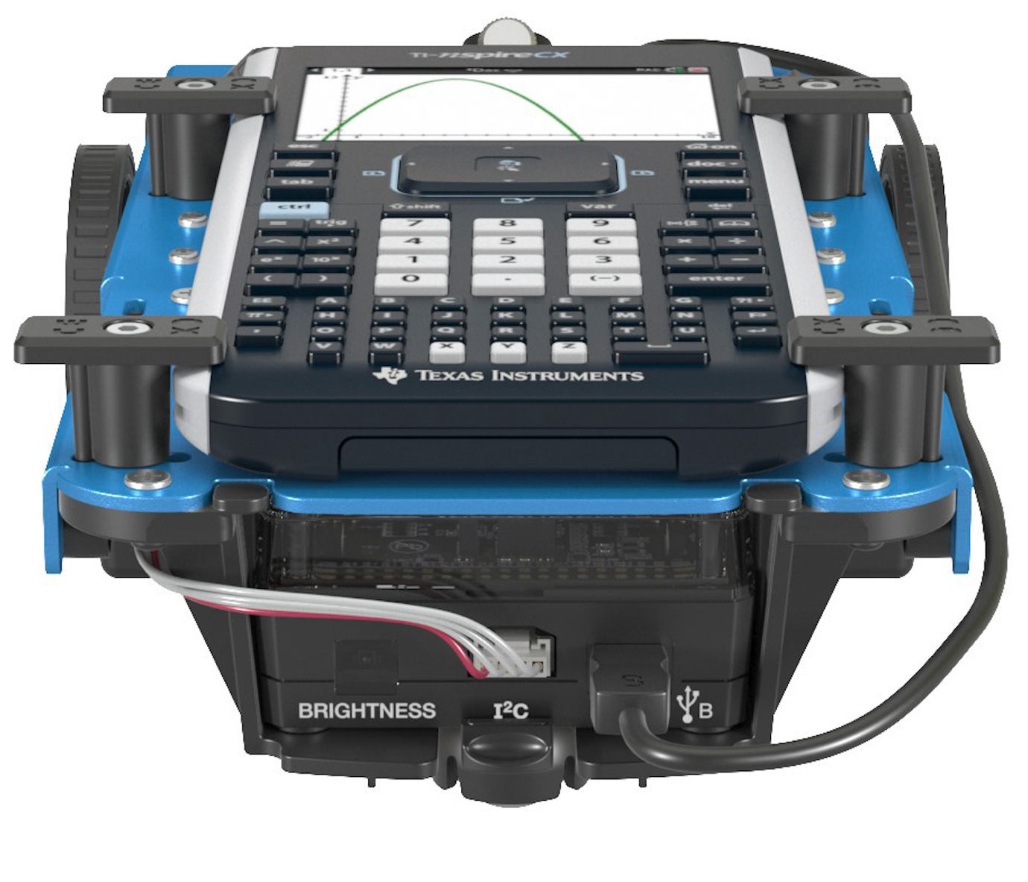
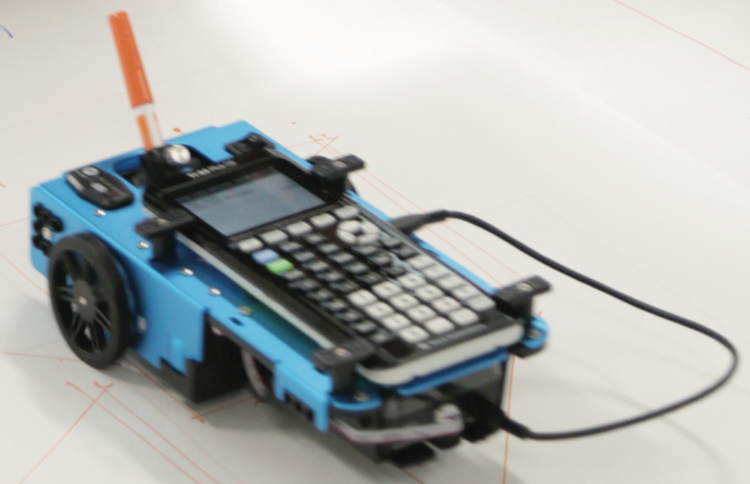
Connecting Rover to your calculator
1
Make sure that your Rover is switched on.
3
Plug A side into port on calculator the Rover Hub.
2
Plug B side into USB B port of the Rover Hub.
Unit-to-unit cable

Slide 9
Connecting your calculator to the Rover
Initial Connection
Step 1: Make sure that Rover is switched ON
Step 2: plug unit-to-unit cable into Hub
(Use end of cable labeled B)
Step 3: plug unit-to-unit cable into the calculator
(Use end of cable labeled A)
Troubleshooting
Try the following as a fast fix:
Step 1: unplug the unit-to-unit cable from the hub and the calculator.
Step 2: re-connect in the order of first Hub then calculator second.
If the fast fix does not work, try these steps:
Step 1: unplug unit-to-unit cable from both the hub and the calculator
Step 2: Switch Rover OFF
Wait a second
Step 3: Switch Rover ON
Step 4: plug unit-to-unit cable into Hub
Step 5: plug unit-to-unit cable into the calculator

Slide 10
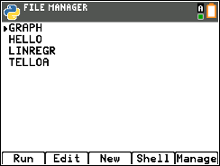
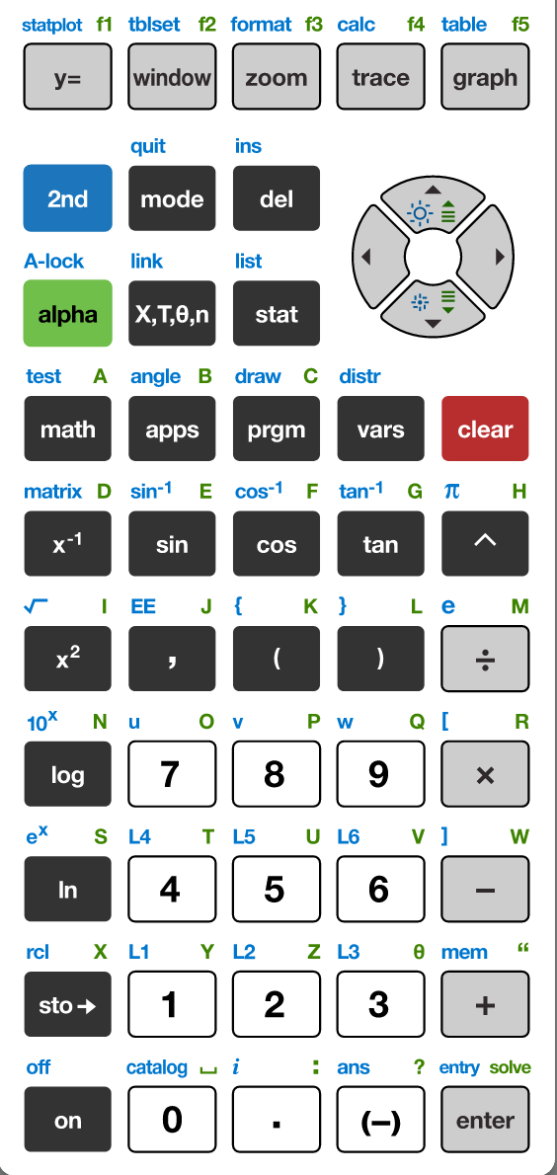
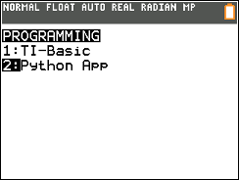
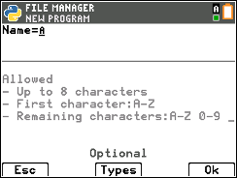
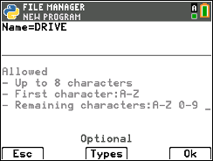
Creating a new Python Program
1
2
3
4
Press down arrow [enter] or Press [2] to
select 2: Python App
You have the option to run, edit, create or manage programs.
Press [New] softkey (zoom button)
5
6
7
Press the [prgm] key to create, edit and execute
TI-Python programs.
You are prompted to enter a program name.
The blinking A cursor shows that you are in alpha entry mode. The
green alpha labels on the keys are active.
Type your program name and press [Ok].
You are now in position to begin entering statements to your program.

Slide 11
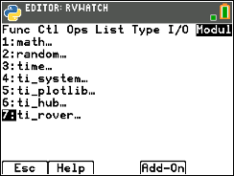
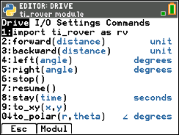
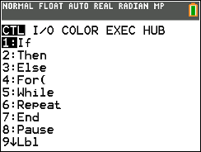
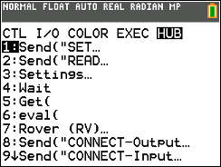
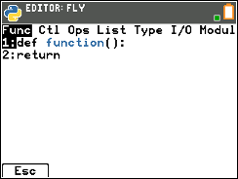
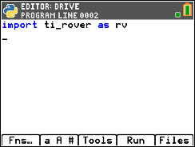
Entering a TI-Rover Program – importing the TI-Rover module and connecting to a Rover
1
2
3
4
The Python program editor uses an insert cursor and a backspace delete.
Press [Fns…] softkey to see functions to use in your program.
Press right arrow repeatedly or
left arrow to move to the Modul
menu.
You will see a menu of installed modules available to use functions from. Select 7:ti_rover.
Select 1:import ti_rover as rv.
5
The ti_rover module import statement is pasted to your program. The ti_rover import statement is required at the beginning of every Rover program. This import statement brings in Rover functions to use in your program, sets Rover’s initial position and sets up communication between the Rover and the Hub.

Slide 12
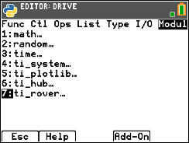
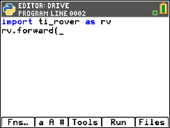
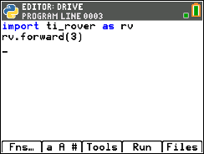
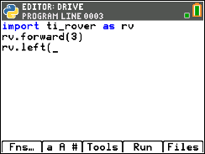
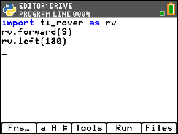
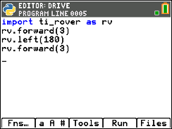
Entering a TI-Rover Program
1
2
3
4
You are now ready to enter functions to control your Rover. Navigate to the Rover menus by pressing [Fns…] then arrow to the Modul menu.
Then select ti_rover... to see options.
You begin on the Drive menu. Select the 2:forward() function.
Enter a value for the number of Rover units to drive forward. Arrow to the end of the statement and press [enter] to move to the next statement.
A faster approach is to use [2nd] [enter] from any place on a line to complete the statement and move the cursor to the beginning of a blank line below.
Note: It is important that each statement begin on a new line.
5
6
7
8
Navigate to the Drive menu again by press [fns…], left arrow, 7:ti_rover...,4:left() to select the left turn function.
Enter a value for the angle to turn in degrees. Press [2nd] [enter] to move to the next statement.
Navigate to the Drive menu again, then select 2:forward(). After the function is pasted enter the Rover units to drive. Press [2nd] [enter] to move to the next statement..
You are now ready to run your TI-Rover program.
.

Slide 13
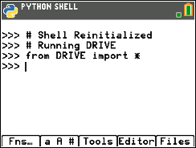
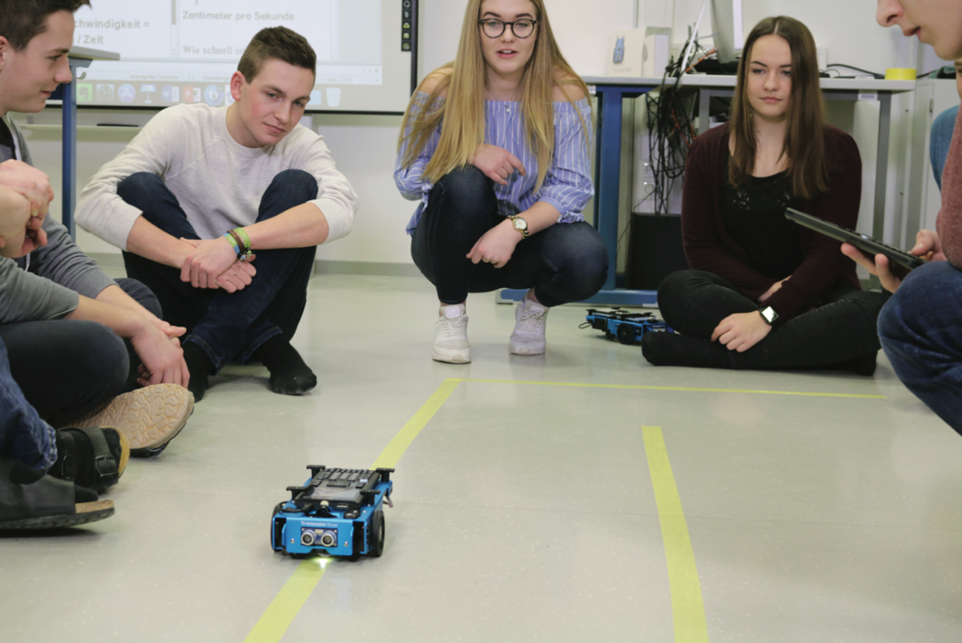
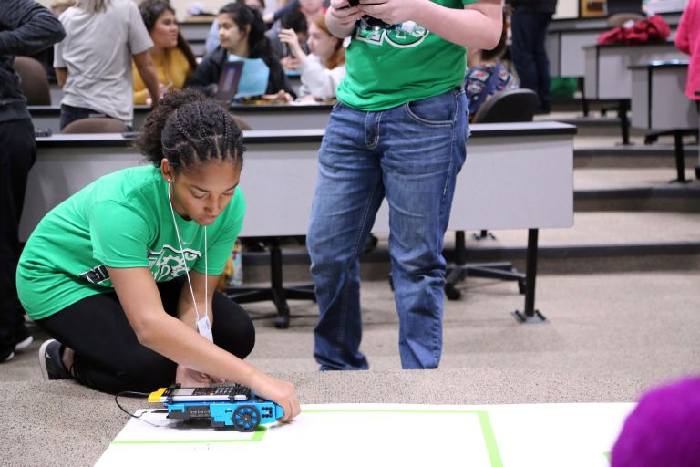
Running a TI-Rover Program
1
2
You are now ready to run your program.
Before pressing [Run] go through the pre-drive checklist.
Make sure that TI-Rover is turned ON.
Make sure that the calculator unit-to-unit cable is connected to the Hub inside the Rover. Plug the B end of the cable into the Data USB B port of the Hub. Plug the A end of the cable into the calculator.
Press [Run].
The program will run in the Python shell. You will receive messages on the status of the program.
You can run the program again by pressing [Tools] and selecting 1:Rerun Last Program from the menu.
You can return to the program editor by pressing [Editor].

Slide 14
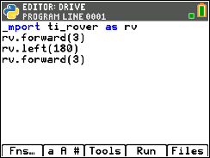
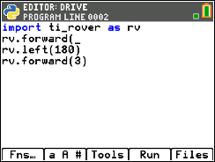
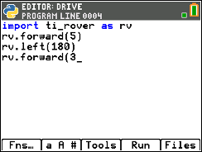
Editing a Rover Program
1
2
3
4
Press [Editor] to go back to your Python editor page.
Use the arrow keys to position the cursor to change the value of the forward distance.
Press [del] to backspace over the 3.
Type in a new value for distance,
right arrow to the end of the line,
then down arrow to position the
cursor to change the value of
the second forward() function.
5
6
7
Press [del] to backspace over the current distance value. Type in a new value for distance, Press [2nd] [enter] to move to the next statement.
Press [Run] to run the program in the Python shell.

Slide 15
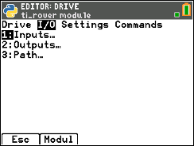
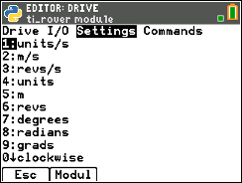
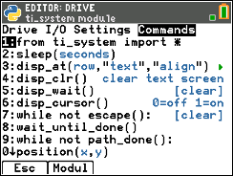
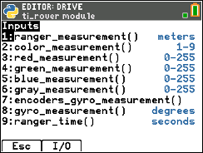
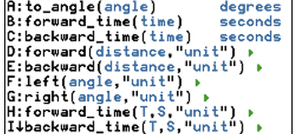
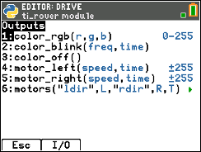
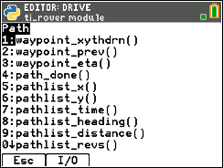
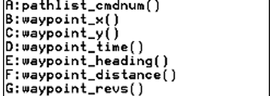
TI-Rover Module Menus
Drive
Input/Output (I/O)
Settings
Commands

Slide 16
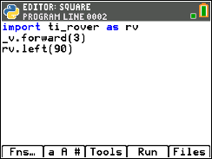
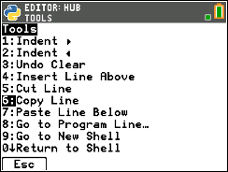
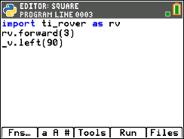
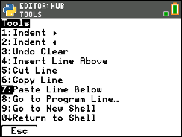
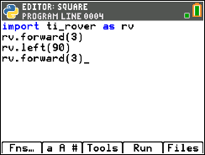
Copying and Pasting a Line of Code
1
2
3
4
Use arrow keys to move the cursor to a position anywhere on the line that you would like to copy.
Press [Tools] then select 6:Copy Line from the menu.
After you select you will be returned to the editor.
Use arrow keys to move the cursor to any location on the line above where you would like to insert the copied line.
Press [Tools] then select 7:Paste Line Below from the menu. The copied line will be pasted.
5
You can paste again by returning to the [Tools] menu and selecting 7:Paste Line Below.

Slide 17
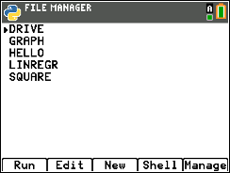
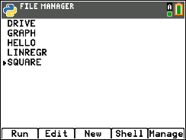
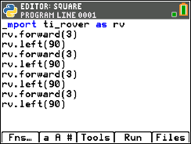
Opening an existing Python Program File
1
2
3
4
5
Press [enter] or
Press [2] to
select 2: Python App
To edit an existing program, use the Up and Down Arrow keys to select a program.
Press [Edit] to open with Python Editor with the selected program.
You can now make changes to the program or run the program.
Press the [prgm] key to create, edit and execute
TI-Python programs.

Slide 18
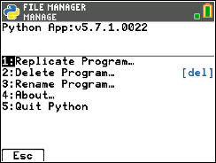
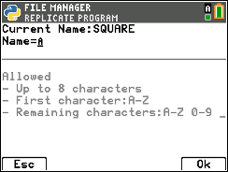
Copying/Replicating a Python Program File
1
2
3
4
Press [Files] to return to the file management screen.
Use the Up and Down Arrow keys to select a program.
Press [Manage] to see file options.
Select 1:Replicate Program to receive a prompt.
5
6
7
Type in the name of the new program using the green alpha key labels.
To use a number in the name, exit alpha mode by pressing [2nd] [alpha] then a number key.
Press [Ok] to finish the dialogue.
You are now in the editor ready to make changes or to run the new program.

Slide 19
Entry and Edit Tips
Use number key shortcuts or arrow keys and [enter] to select from menus
Use arrow keys to move the cursor around the screen.
Use [alpha] repeatedly to cycle from numeric, to lower case alpha to upper case alpha entry mode. The cursor indicates the current mode.
Use [2nd] [A-lock] to lock to alpha entry or to return to numeric entry.
Use [Fns…] softkey to bring up Python function menus, including the Modul (modules) menu.
Use [clear] or [Esc] softkey to back out of a menu.
Use [del] as a destructive backspace
Use [2nd] [enter] from any place on a line to complete the statement and move the cursor to the beginning of a blank line below.
Use [Tools] softkey menu to undo a clear and to copy, cut, paste and more.
Use [Editor] softkey to return to the editor from the Shell.
Use [2nd] [quit] to leave the Python app and return to the calculator.

Slide 20
Drawing with the TI-Rover
Use Expo Fine or Extra Fine dry erase markers.
The markers drop into a slot on the front of the Rover.
Note: The Texas Instruments Workshop Loan Rover cases include markers.
Drawing surface: We recommend butcher paper held in place with painters tape on a hard surface.

Slide 21
MAKE IT MOVE!
New Program:
Task: Discover how far Rover drives per unit.
Use differing values (1-20) to determine what 1 Rover unit is.
From the Python shell, press [Editor] to move from the shell to the Python editor.
Press [Fns…], left arrow, then 7:ti_rover… for the Rover menus.
Press [Run] to run the program in the Python shell.
Notes:
Explain import ti_rover module
Then demo how to import and how to enter the statements.
Give students time to explore with different distances to figure out.
Use [ctrl] left and [ctrl] right to move from page to page in the document.

Slide 22
Set the color
New Program:
Task: Set the color output of the RGB LED.
Each color takes a value (0-255).
Challenge Task: Try to make Yellow
Find the color_rgb( ) function on the Rover Outputs menu.
Enter values for the red, green and blue components of the color to display.
Press [Fns…], left arrow, then 7:ti_rover… for the Rover menus.
Press [Run] to run the program in the Python shell.
Notes:
Explain import ti_rover module
Then demo how to import and how to enter the statements.
Give time to explore.

Slide 23
Explore angles
New Program:
Task: Drive a square.
Challenge Task: Try to drive an equilateral triangle.
See the inputs for the most common drive functions below.
The program above is a framework for driving a square.
Enter values for distance and turn angle.
Press [Fns…], left arrow, then 7:ti_rover… for the Rover menus.
Press [Run] to run the program in the Python shell.
Notes:
Explain import ti_rover module
Then demo how to import and how to enter the statements.
Give time to explore.

Slide 24
Quick Math Reminders
Complementary Angles:
Sum to 90 degrees
Supplementary Angles:
Sum to 180 degrees

Slide 25
Quick Math Reminders
Exterior angles:
Interior Angles:

Slide 26
Logic Challenge
Task: Drive the figure shown without crossing any lines or going back over a line and without picking up the pen.
When you are ready put the pen in and trace your path
Notes:
First challenge is to drive the shape without crossing any lines and without picking up the pen.

Slide 27
Where can you go next with TI-Rover?
Drive an obstacle course
Drive a design
Draw artwork
Use a For loop
to draw polygons
Write your name
Navigate a map
Park your Rover

Slide 28
Quick Math Reminders
Pythagorean Theorem

Slide 29
Logic Challenge 2
Task: Drive the figure shown without crossing any lines or going back over a line and without picking up the pen.
When you are ready put the pen in and trace your path
Import the Python Math module in addition to the Rover module for this challenge.
Notes:
We will need to import the math library
First challenge is to drive the shape without crossing any lines and without picking up the pen.
Second will be to drive at least one segment in reverse direction.

Slide 30
Logic Challenge 2
3
2
4
5
6
1
7
9
8
10
Notes:
First challenge is to drive the shape without crossing any lines and without picking up the pen.
Second will be to drive at least one segment in reverse direction.

Slide 31
Logic Challenge 3
Task: Drive the figure shown without crossing any lines or going back over a line and without picking up the pen.
Now match the colors using the RGB LED. Don’t worry about using the pen.
Import the Python Math module in addition to the Rover module for this challenge.
Use wait_until_done() from the Rover Commands menu to synchronize Rover drive functions with the RGB LED.
Notes:
We will need to import the math library
First challenge is to drive the shape without crossing any lines and without picking up the pen.
Second will be to drive at least one segment in reverse direction.

Slide 32
Thank you!
See www.TIstemProjects.com for more TI STEM and coding activities and projects.

