Slide 1
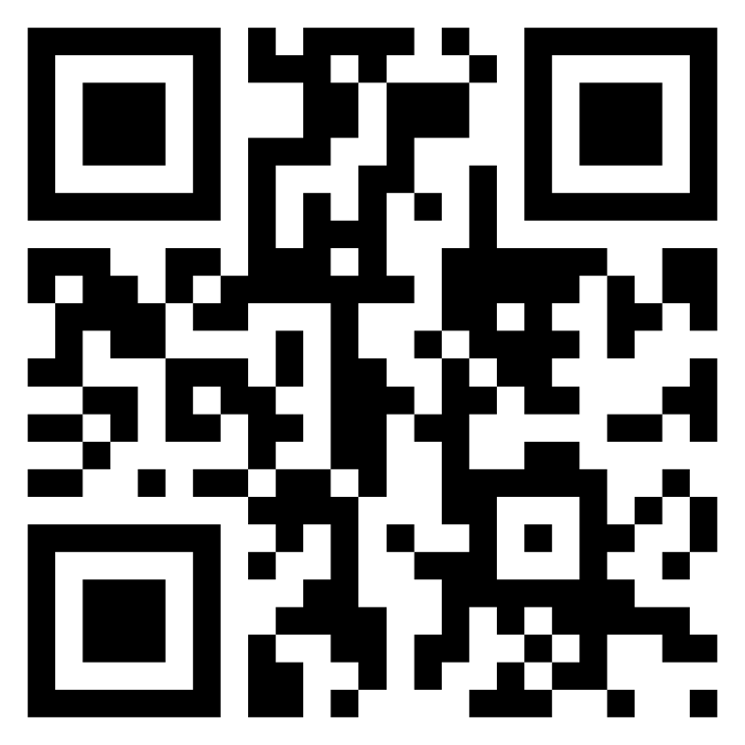
Meet the TI-Rover with Geometry Challenges TI-Nspire CX Family TI-Basic
Texas Instruments
@ticalculators
www.TIstemProjects.com
Contact stem-team@ti.com with questions

Slide 2
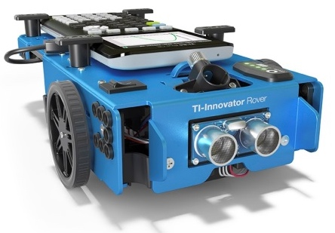
Meet the TI-Innovator™ Rover

Slide 3
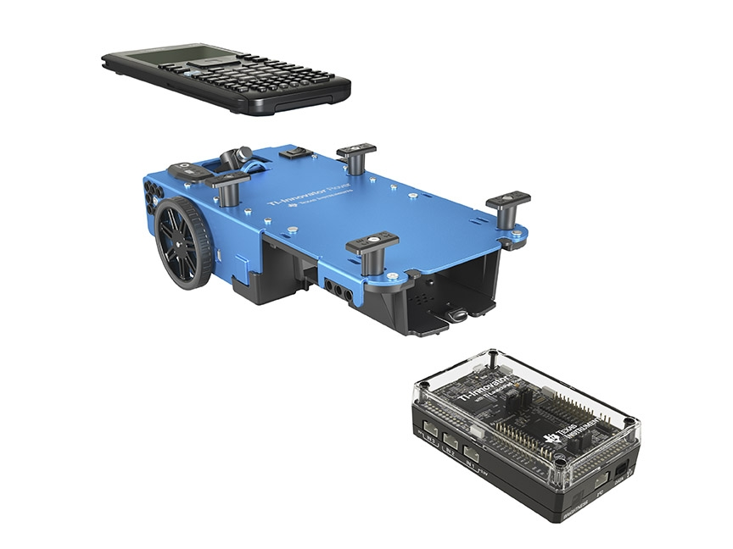
TI Graphing Calculator
TI-Innovator™ Rover
TI-Innovator™ Hub

Slide 4
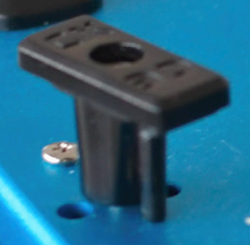
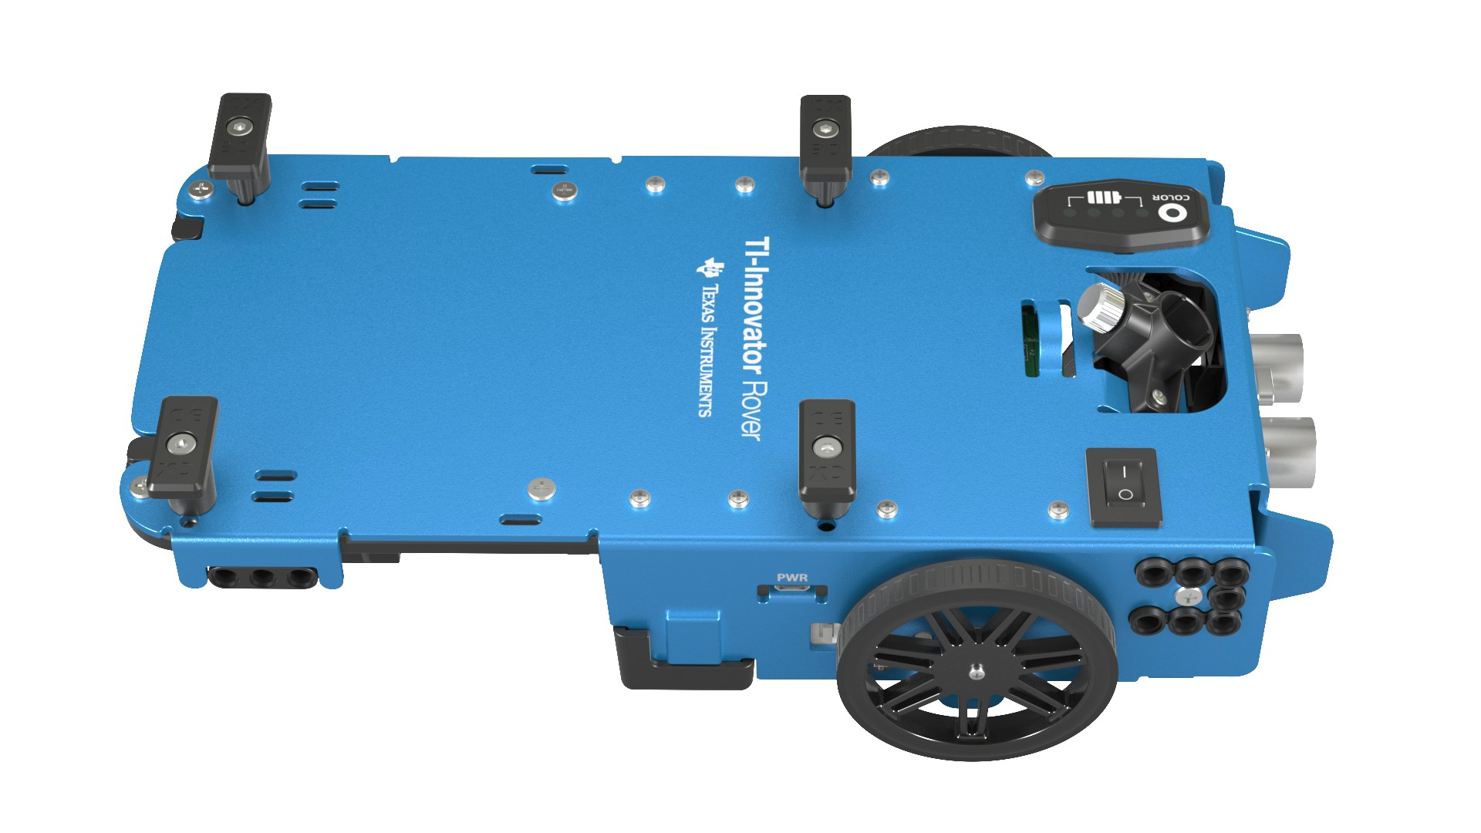
Rover from the top
Calculator holder posts.
Lift and twist to CE or CX side.
Red-Green-Blue (RGB) Color LED
Battery indicator
Marker holder
(Expo Fine and
Ultra Fine sizes)
Battery Charge with USB micro to wall adapter.
On/Off Switch

Slide 5
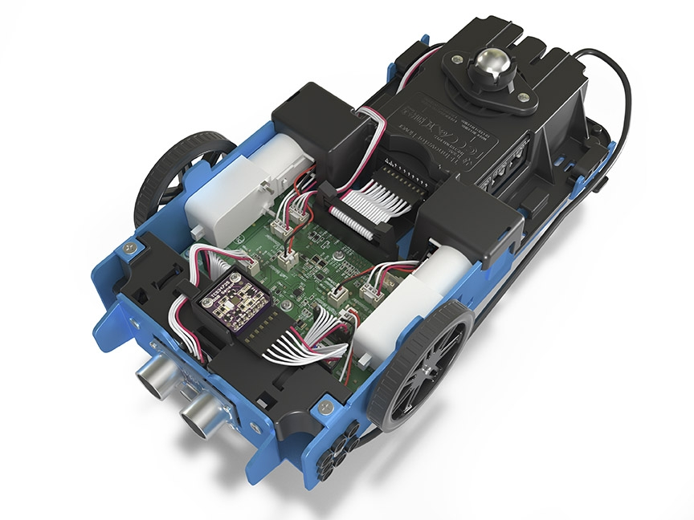
Turn Rover Over
What do you see?

Slide 6
Sensors on Rover
Motors to turn the wheels
Color sensor to detect different colors
Ranger to measure distance

Slide 7
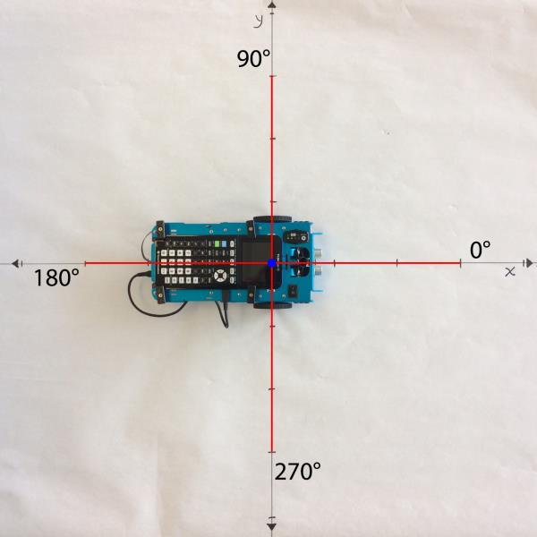
TI-Rover orientation and virtual grid
Rover programs set the initial position as the origin and the heading as 0 degrees measured from the x-axis.
Note: The Rover tracks its position on a virtual coordinate grid with a unit value of 10 cm. The coordinate grid position applies to the RV TO XY, RV TO POLAR, and RV TO ANGLE on the Drive RV Drive menu. The virtual grid also applies to the RV Path menu functions.

Slide 8
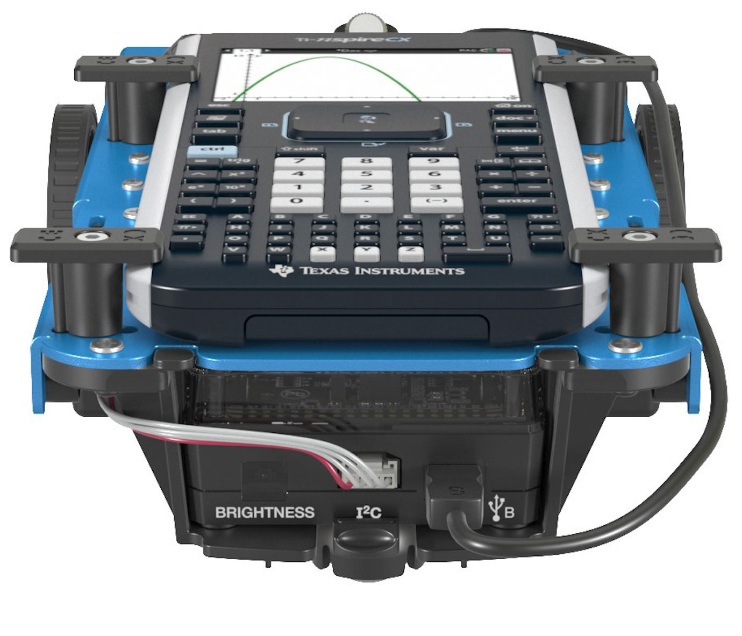
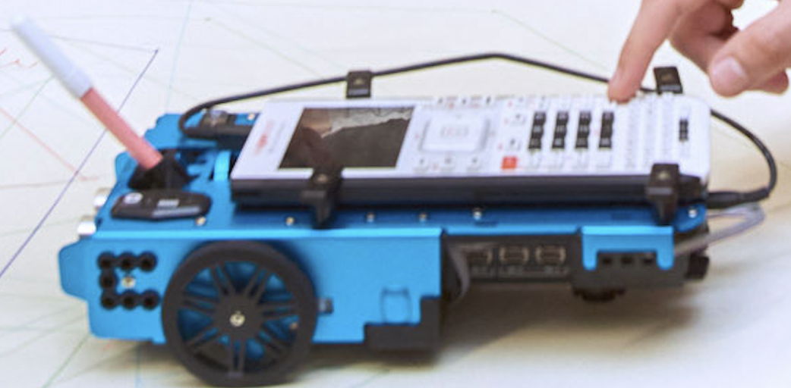
Connecting Rover to your calculator
3
Make sure that your Rover is switched on and
on floor ready to roll before running the program.
1
2
Plug B side into USB B port of the Rover Hub.
Plug A side into port on calculator the Rover Hub.
Unit-to-unit cable

Slide 9
Connecting your calculator to the Rover
Initial Connection
Step 1: Make sure that Rover is switched ON
Step 2: plug unit-to-unit cable into Hub
(Use end of cable labeled B)
Step 3: plug unit-to-unit cable into the calculator
(Use end of cable labeled A)
Troubleshooting
Try the following as a fast fix:
Step 1: unplug the unit-to-unit cable from the hub and the calculator.
Step 2: re-connect in the order of first Hub then calculator second.
If the fast fix does not work, try these steps:
Step 1: unplug unit-to-unit cable from both the hub and the calculator
Step 2: Switch Rover OFF
Wait a second
Step 3: Switch Rover ON
Step 4: plug unit-to-unit cable into Hub
Step 5: plug unit-to-unit cable into the calculator

Slide 10
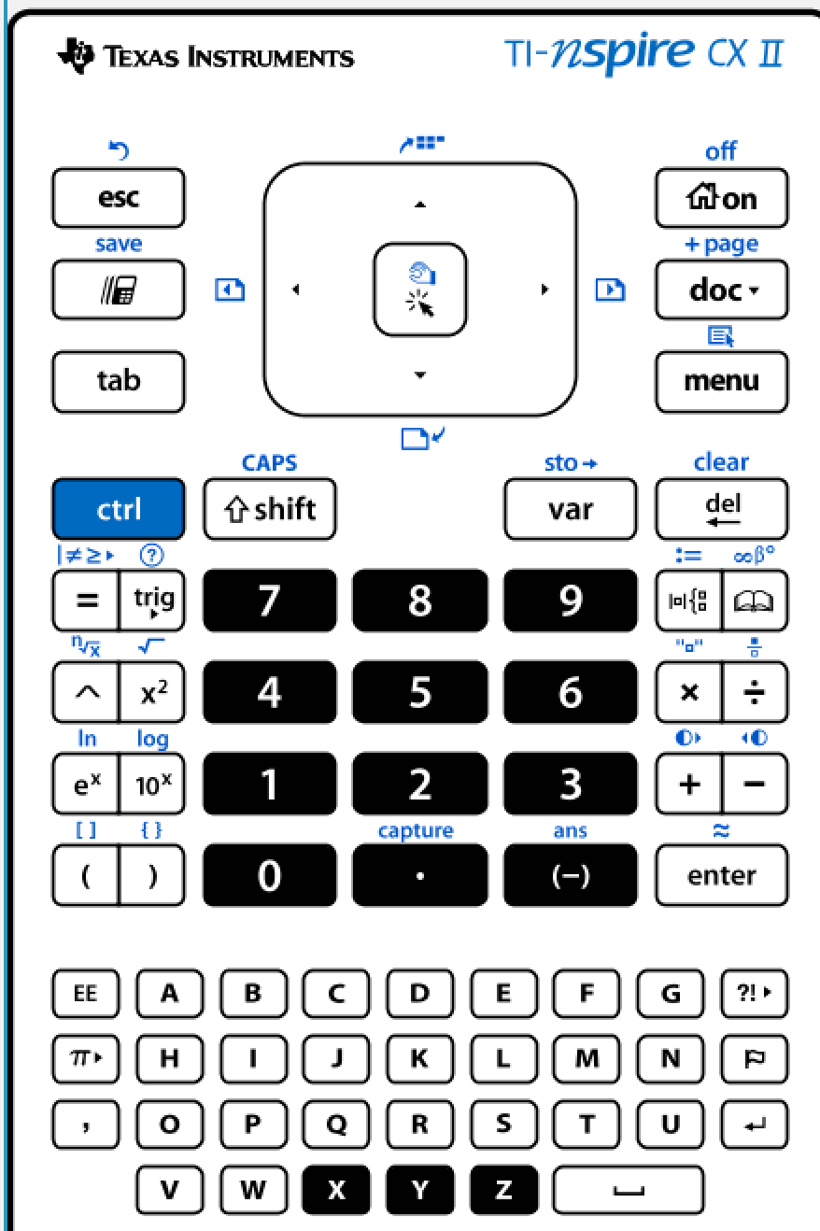
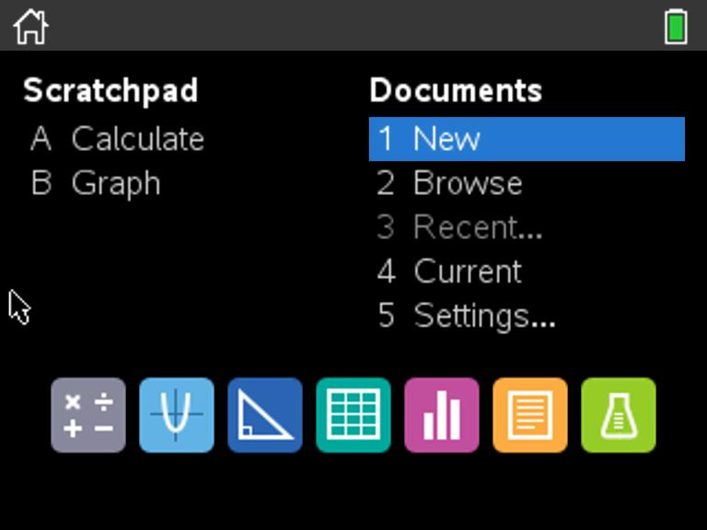
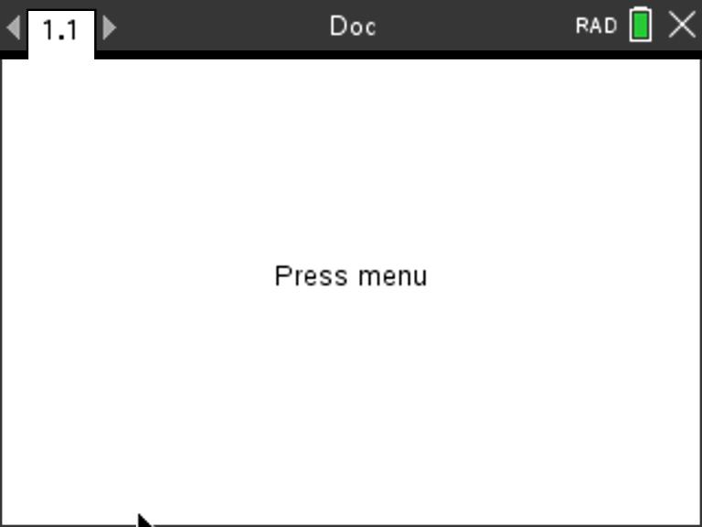
Creating a new TI-Nspire document
1
2
3
Use arrow keys and [enter] or
Press [1] to select 1 New document.
See next slide for steps to add
a program.
Press the [home/on] key to
display the home screen.

Slide 11
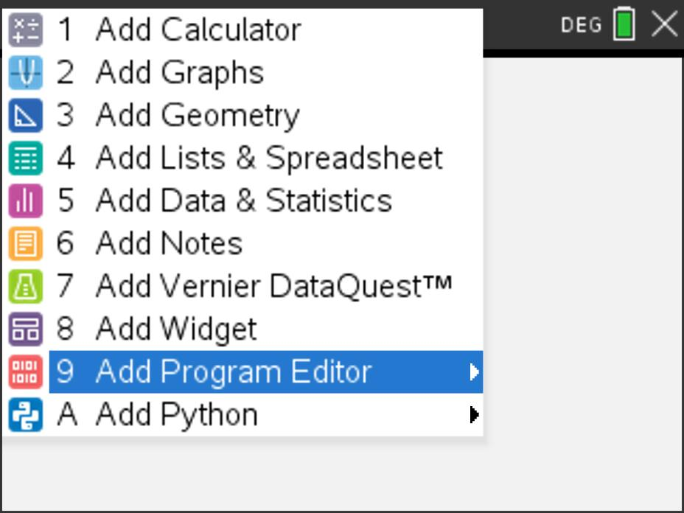
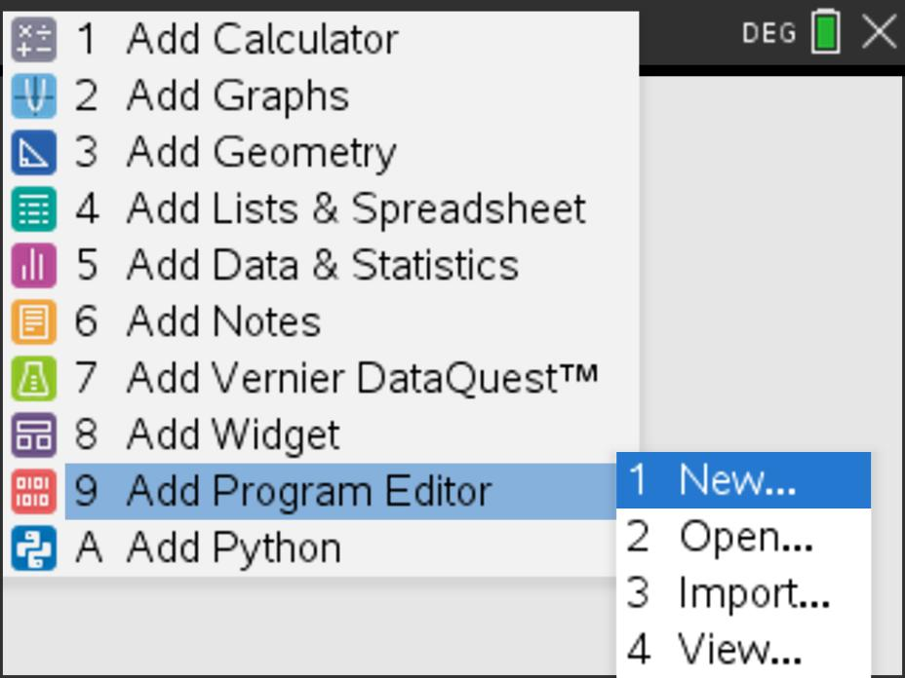
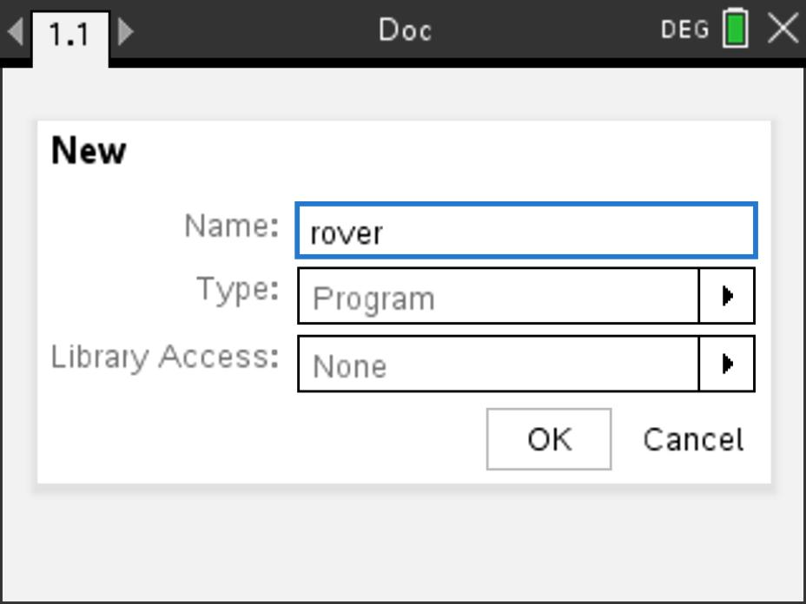
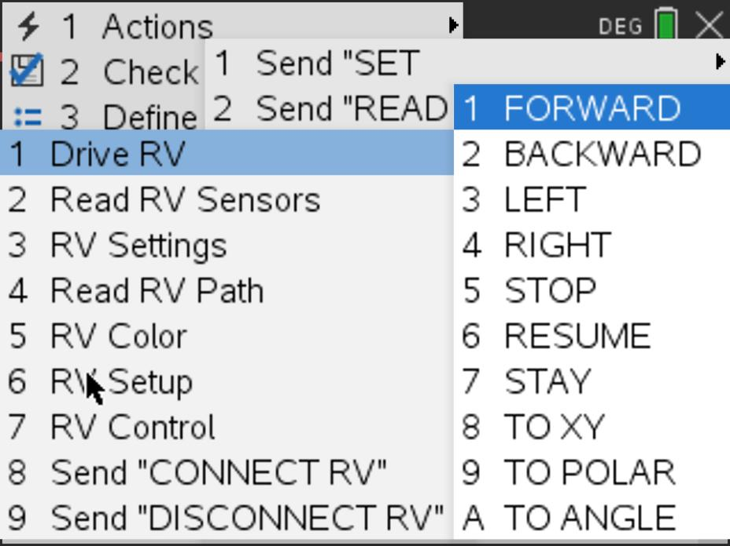
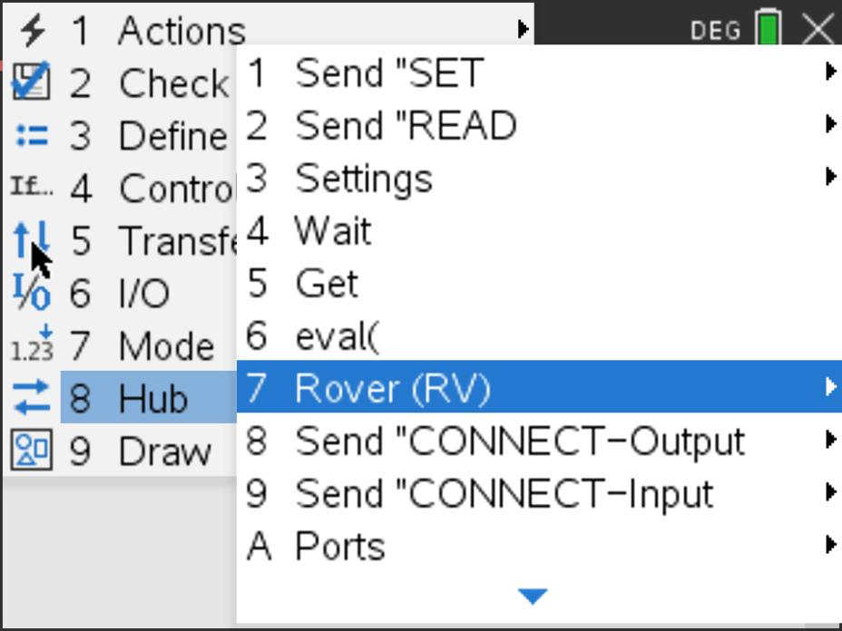
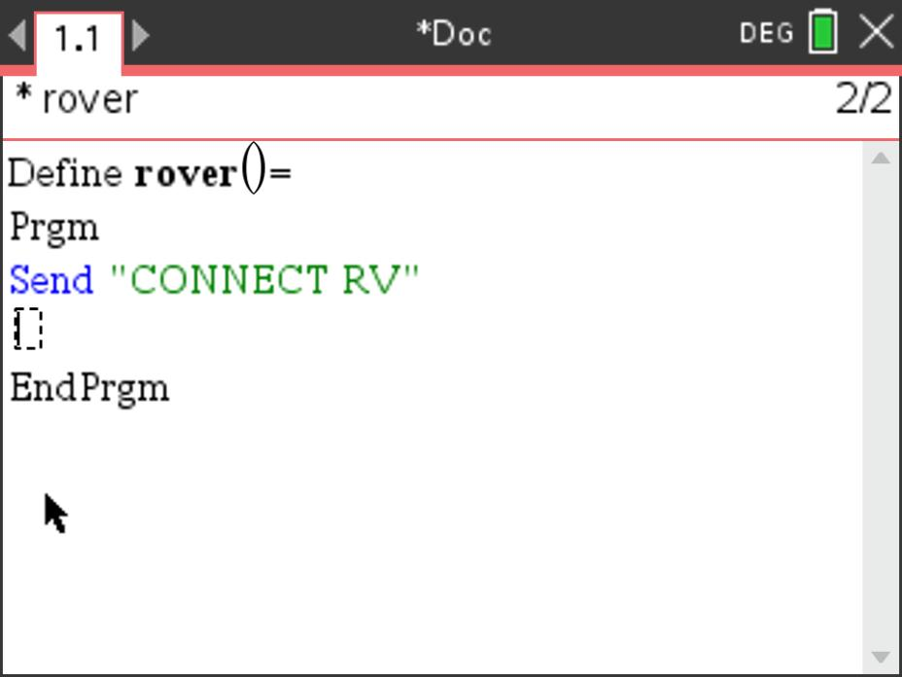
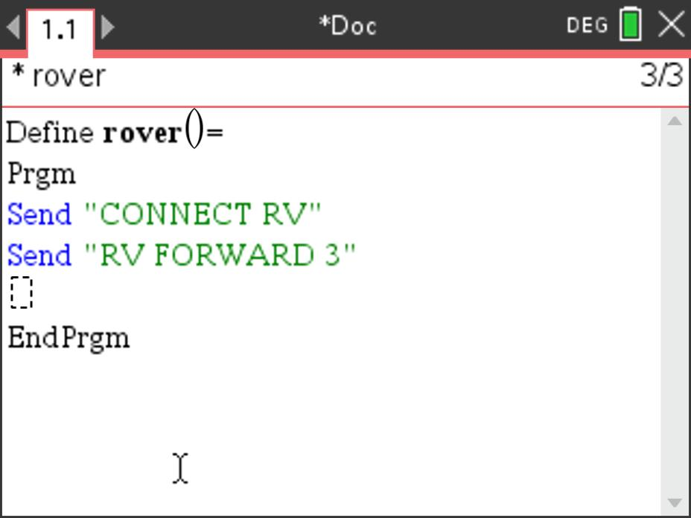
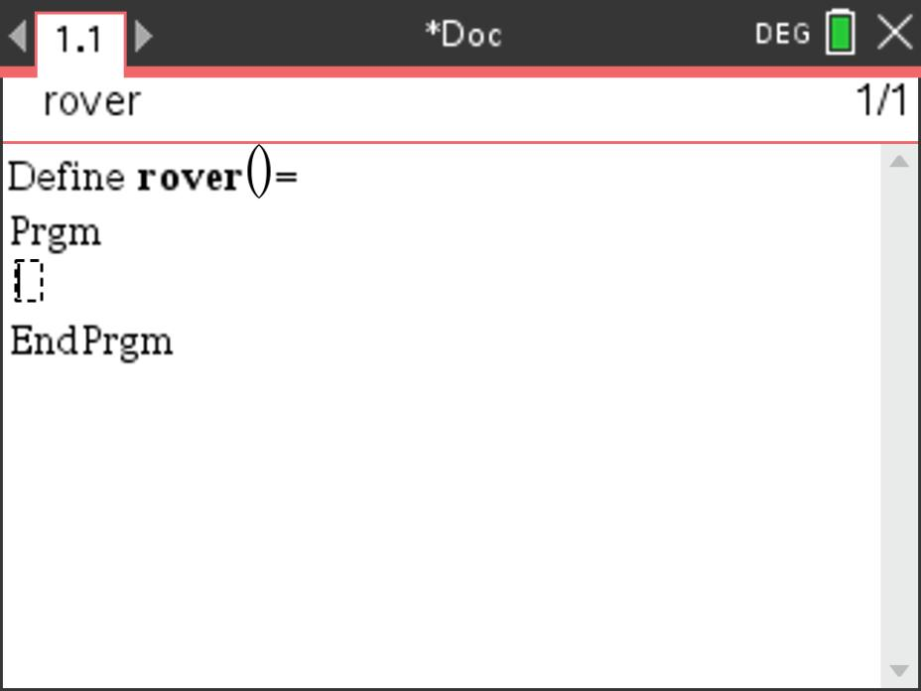
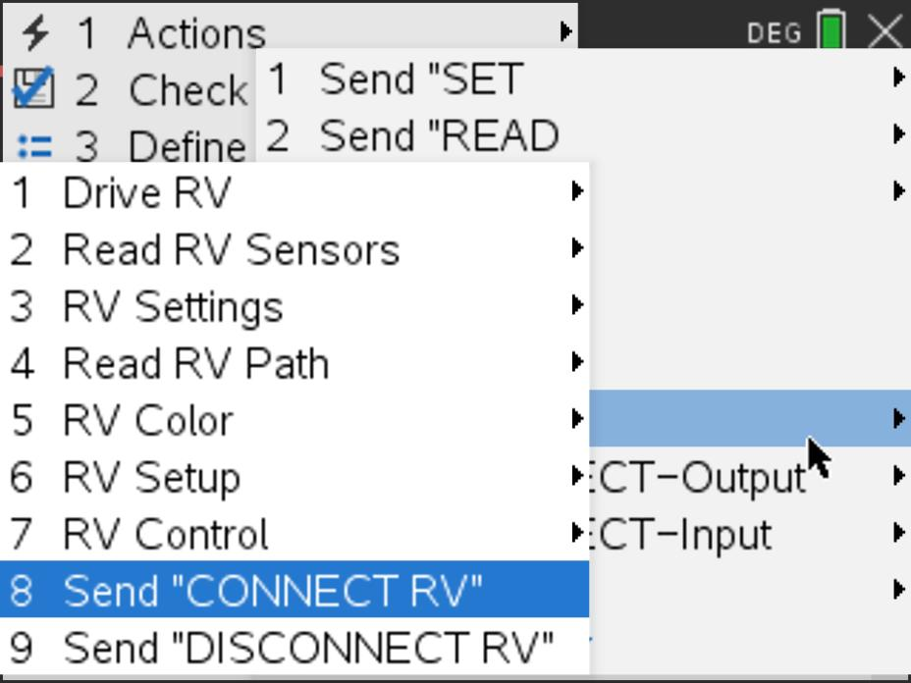
Creating a Rover Program
1
2
3
4
Press [menu] to bring up a menu
of applications to add to the page.
Press down arrow repeatedly then press [enter] or
press [9] to select Add Program Editor.
Select 1: New by pressing [enter] or [1]
Enter your program name
and press [enter].
Note: You can also add a new page
to the document by pressing
[ctlr] [doc] +page.
8
6
7
5
Press [menu] then [8] Hub [7] Rover (RV) [1] Drive RV [1] FORWARD to paste to the edit line. Type a value for units to drive. Right arrow to the end of the line and press [enter] to complete the statement.
Press [ctrl] [R] to run the program in a calculator app on the next page.
The Connect RV command
is required at the beginning of every Rover program. Note: Right arrow to the end of the line and press [enter] to complete the statement.
You begin on a blank program line.
Press [menu] then [8] Hub [7] Rover (RV) [8] Send “Connect RV”

Slide 12
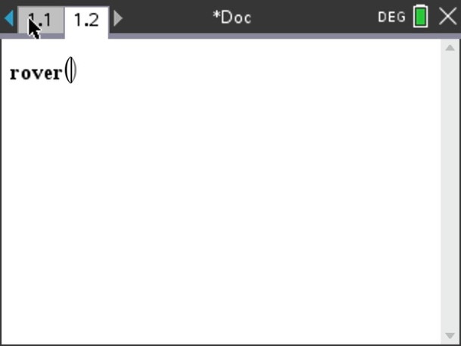
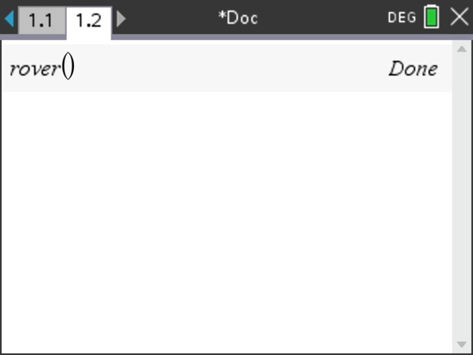
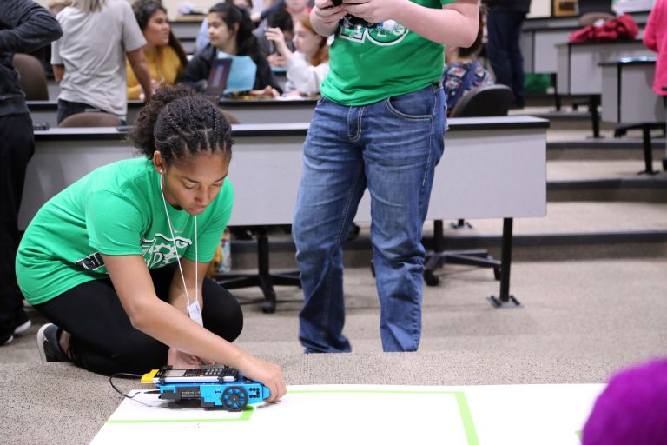
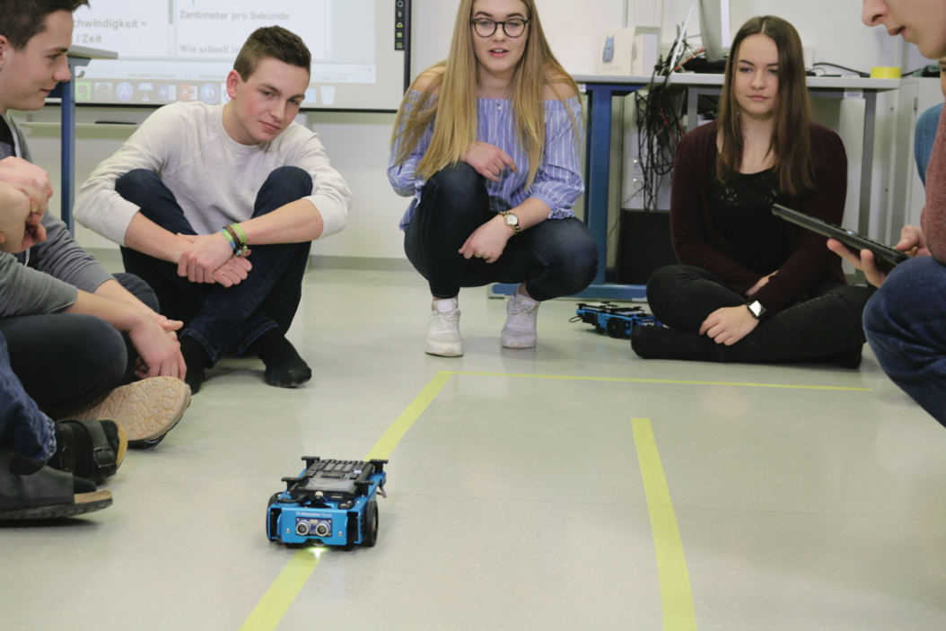
Running a Rover Program
1
2
Press [ctrl] [R] to paste the program name ready to run in a Calculator app on the next page.
Note: [ctrl] [R] also checks syntax and stores program changes. [ctrl] [B] is another option for checking syntax and storing. * before the program name indicates that changes have not been stored.
Before running the program
make sure that
- Rover is connected to the calculator
- Rover is switched on
- Rover is on a flat surface ready to roll
Press [enter] to run your program in the Calculator app.
You can re-run the program in the Calculator app by pressing [enter].

Slide 13
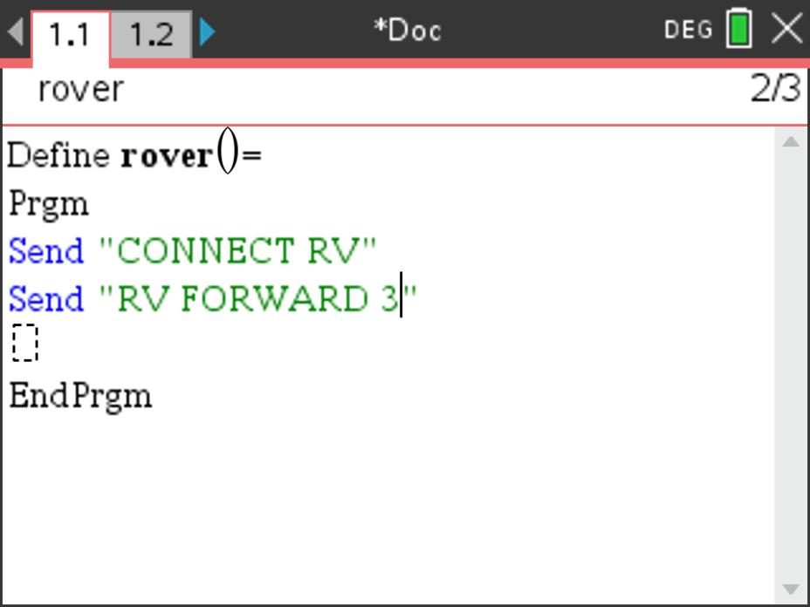
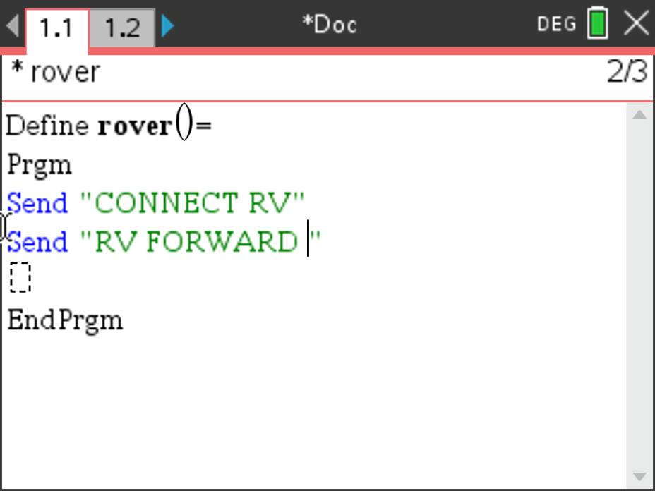
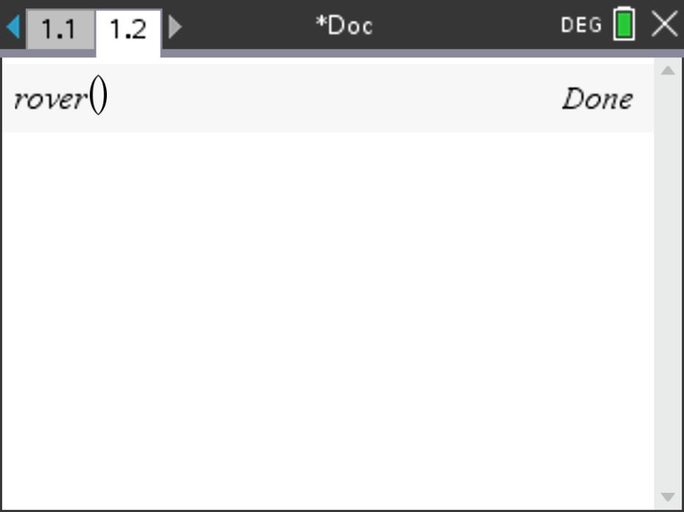
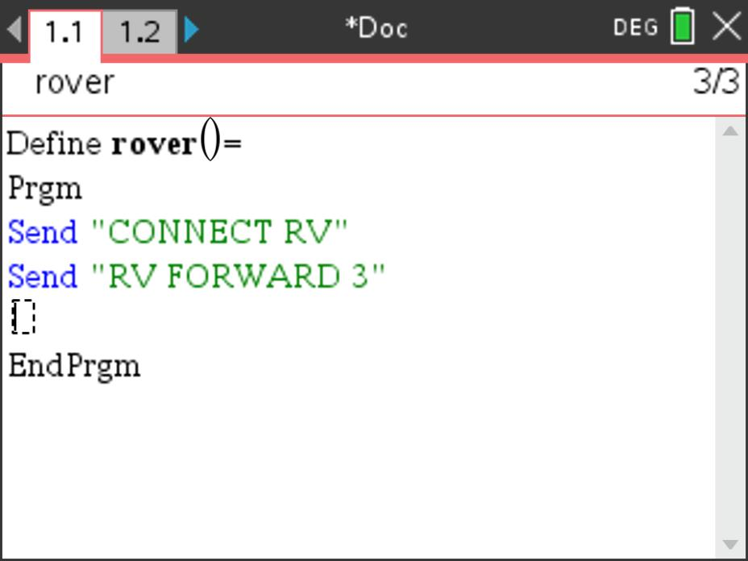
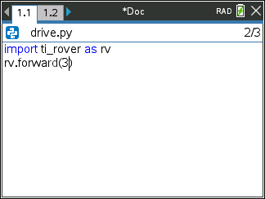
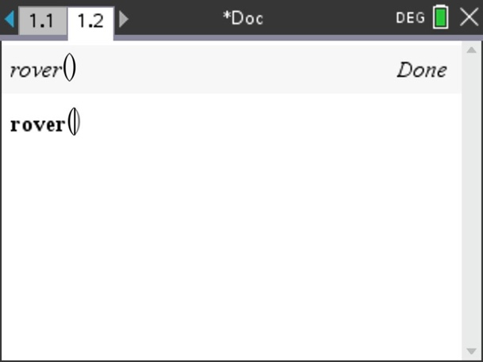
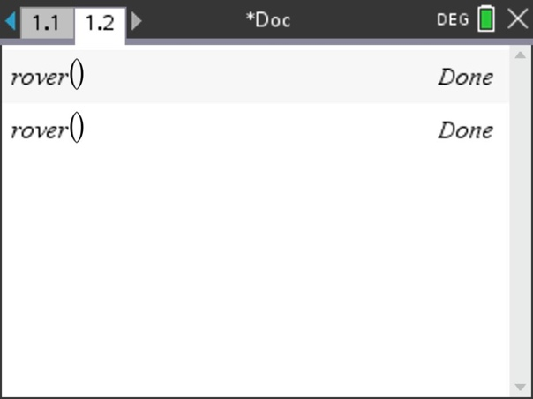
Editing a Rover Program
1
2
3
4
Press [ctrl] left to go back to your editor page.
Use the arrow keys to position the cursor to change the value of the forward distance.
Press [del] to backspace over the 3.
Type in a new value for distance,
right arrow to the end of the line,
then [enter] to move to the next
line.
5
6
Press [ctrl] [R] to paste the program name ready to run in a Calculator app on the next page.
Press [enter] to run your program in the Calculator app.

Slide 14
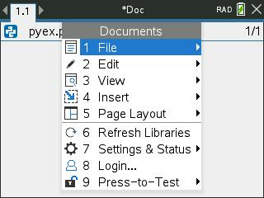
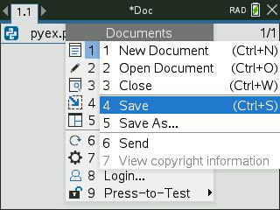
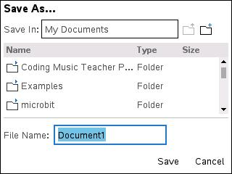
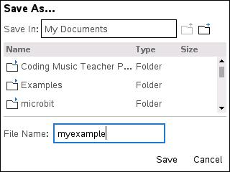
Saving a TI-Nspire document file
Folder where file will be saved.
1
2
3
4
Press [doc] then select 1 File
from the menu by pressing
[enter] or [1].
Select 4 Save or 5 Save As… from the menu.
Type in your file name using alpha and numeric characters.
Note: The name must begin with an alpha character.
Press [enter] to save the file to the
folder indicated above.
To change the folder press the
[UP] arrow key and then use
arrows and [enter] to select a
folder before pressing [enter] to
save the file.
Press [esc] to cancel the save
dialogue.
You can use [ctrl] [S] as a shortcut
to save the TI-Nspire document file.

Slide 15
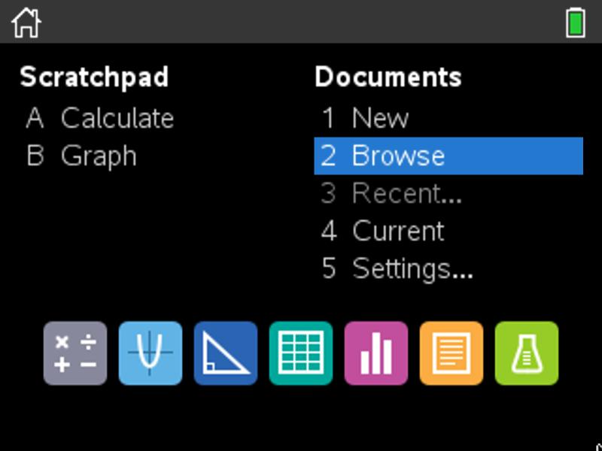
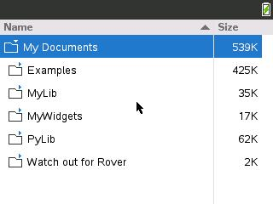
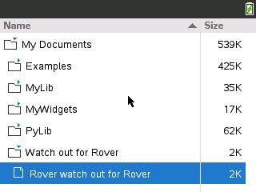
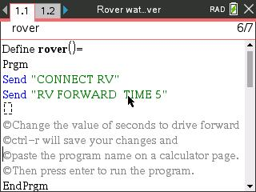
Opening an existing TI-Nspire document file
1
2
3
Use arrow keys and [enter] or
Press [2] to select 2 Browse files.
Use arrow keys and [enter] to select a folder and a file.
Note: Pressing the [home/on] key
repeatedly toggles between the home screen and the current document.
Press the [home/on] key to
display the home screen.

Slide 16
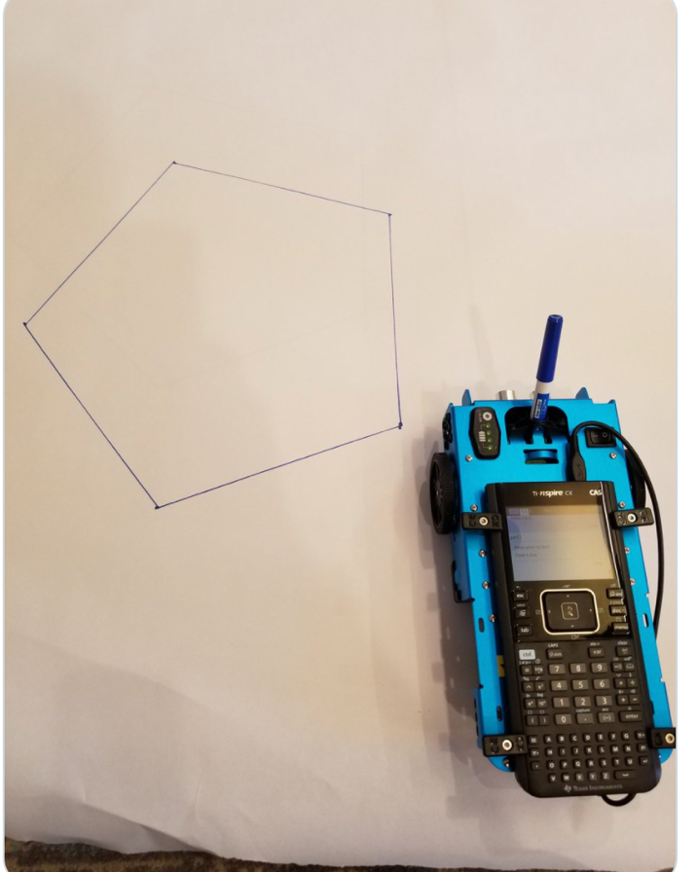
Drawing with the TI-Rover
Use Expo Fine or Extra Fine dry erase markers.
The markers drop into a slot on the front of the Rover.
Note: The Texas Instruments Workshop Loan Rover cases include markers.
Drawing surface: We recommend butcher paper held in place with painters tape on a hard surface.

Slide 17
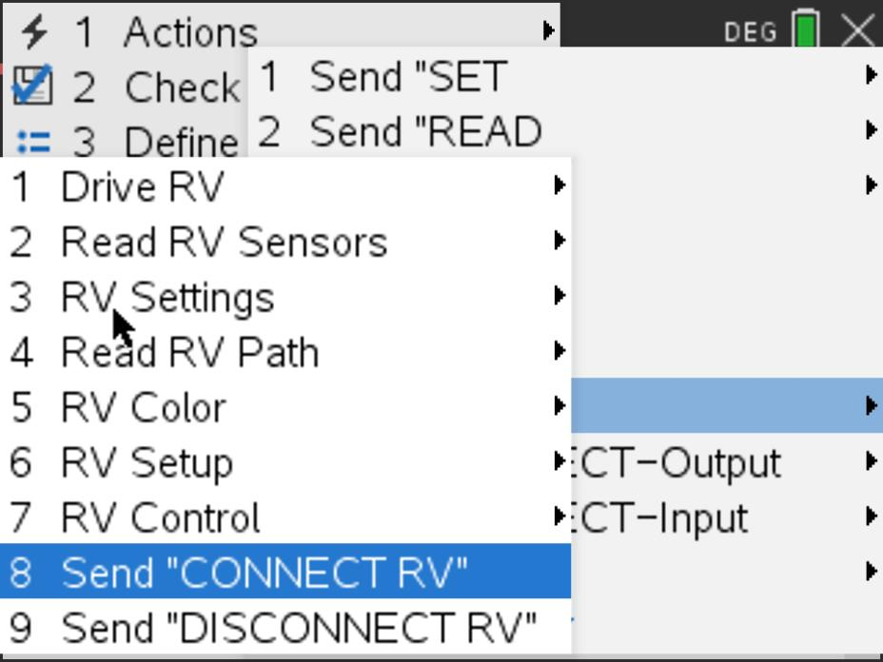
MAKE IT MOVE!
New Program:
Task: Discover how far Rover drives per unit.
Use differing values (1-20) to determine what 1 Rover unit is.
Find ”CONNECT RV” on the 8:Hub>7:Rover menu.
Find FORWARD on the 8:Hub>7:Rover>1:Drive RV menu.
Enter value for number of units to drive.
Right arrow to the end of the line and press [enter] to complete the command and move to the next line.
Press [menu] key to see TI-Basic Program Editor options.
Press [ctrl] [R] to paste the program name ready to run in a Calculator app on the next page. Press [enter] in the Calculator app to run the program.
Use [ctrl] left to move from the Calculator page back to the editor page.
Notes:
Explain “Connect RV”
Then demo how to add Send “CONNECT RV” to the first line in the program.
Give students time to explore with different distances to figure out.
Use [ctrl] left and [ctrl] right to move from page to page in the document.

Slide 18
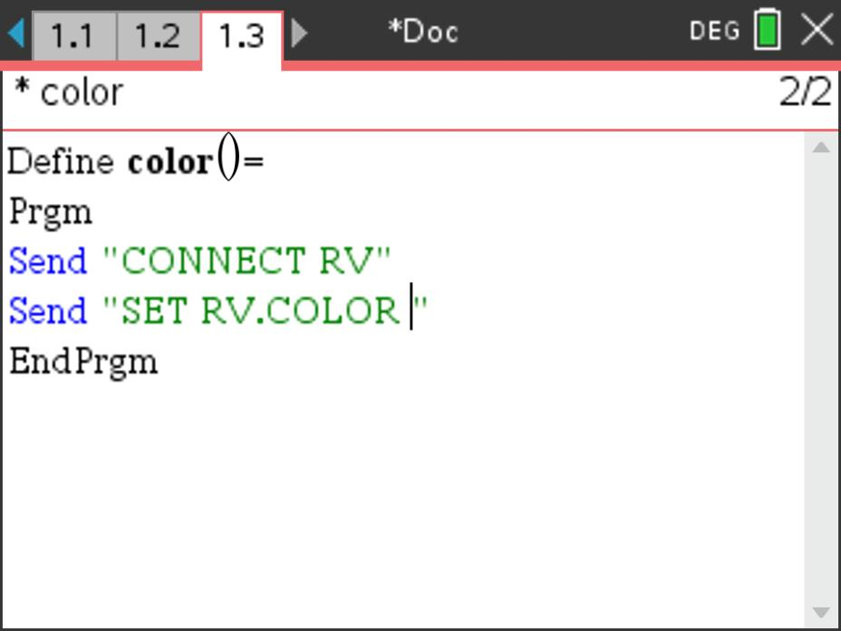
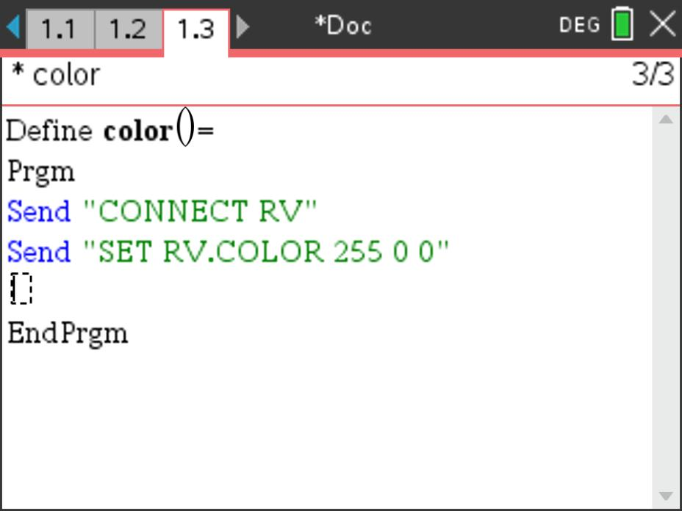
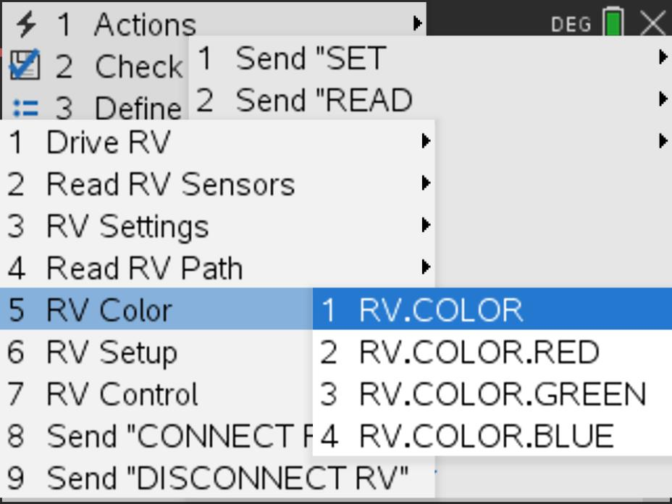
Set the color
New Program:
Task: Set the color output of the RGB LED.
Each color takes a value (0-255).
Challenge Task: Try to make Yellow
Enter values for Red, Green and Blue separated by spaces.
Find RV.COLOR on the 8:Hub>7:Rover>5:RV.Color menu.
Separate the values for Red, Green and Blue with spaces.
.
Press [menu] key to see TI-Basic Program Editor options.
Press [ctrl] [R] to paste the program name ready to run in a Calculator app on the next page. Press [enter] in the Calculator app to run the program.
Use [ctrl] left to move from the Calculator page back to the editor page.
Notes:
Explain import ti_rover module
Then demo how to import and how to enter the statements.
Give time to explore.

Slide 19
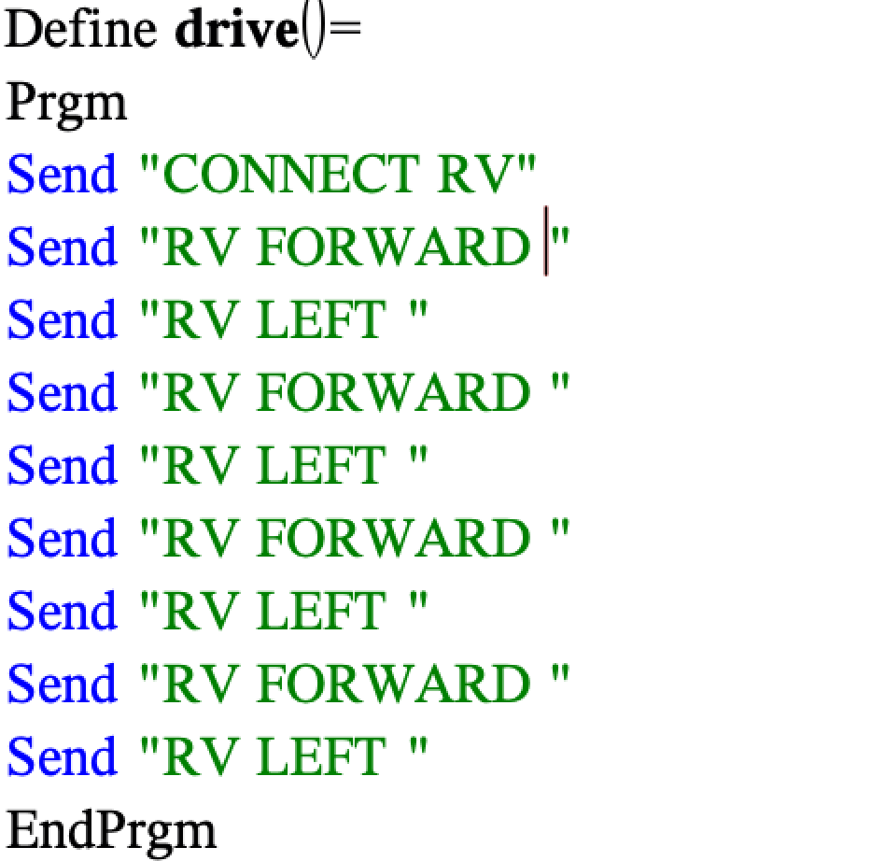
Explore angles
New Program:
Task: Drive a square.
Challenge Task: Try to drive an equilateral triangle.
The program above is a framework for driving a square.
Enter values for distance and turn angle.
Notes:
Explain import ti_rover module
Then demo how to import and how to enter the statements.
Give time to explore.

Slide 20
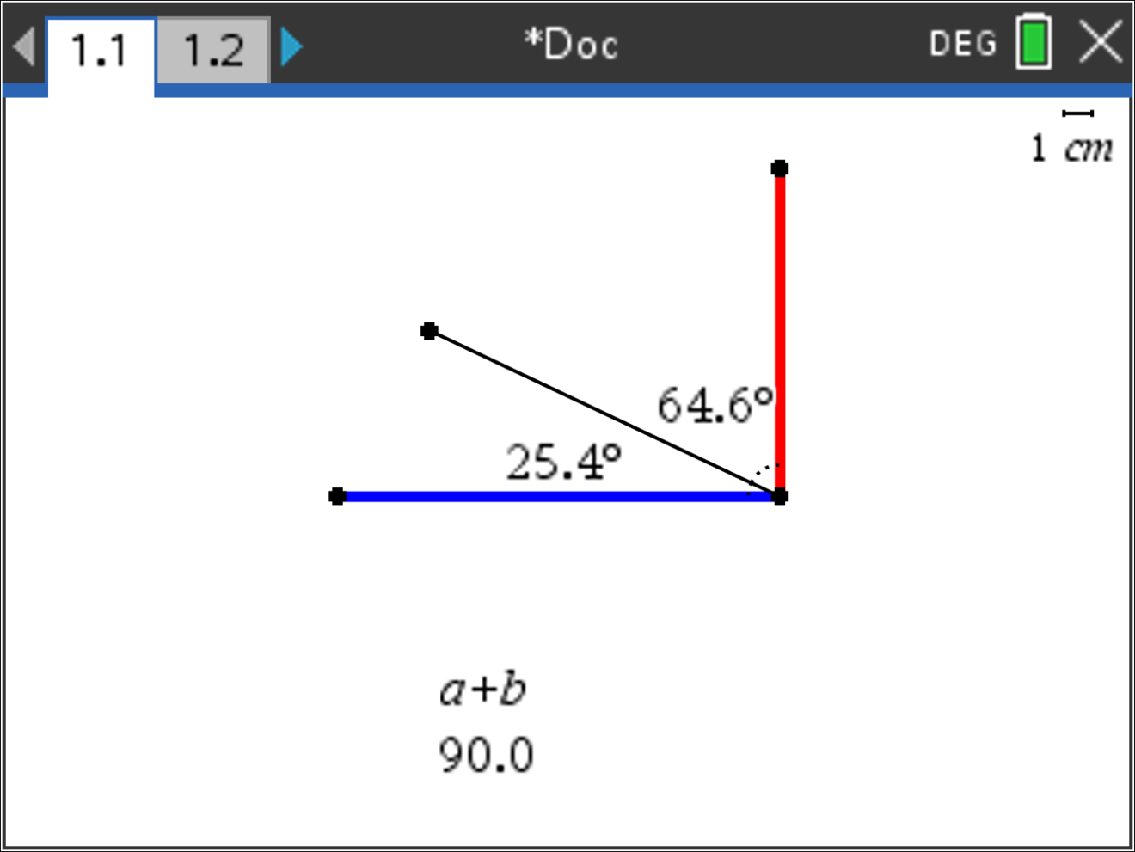
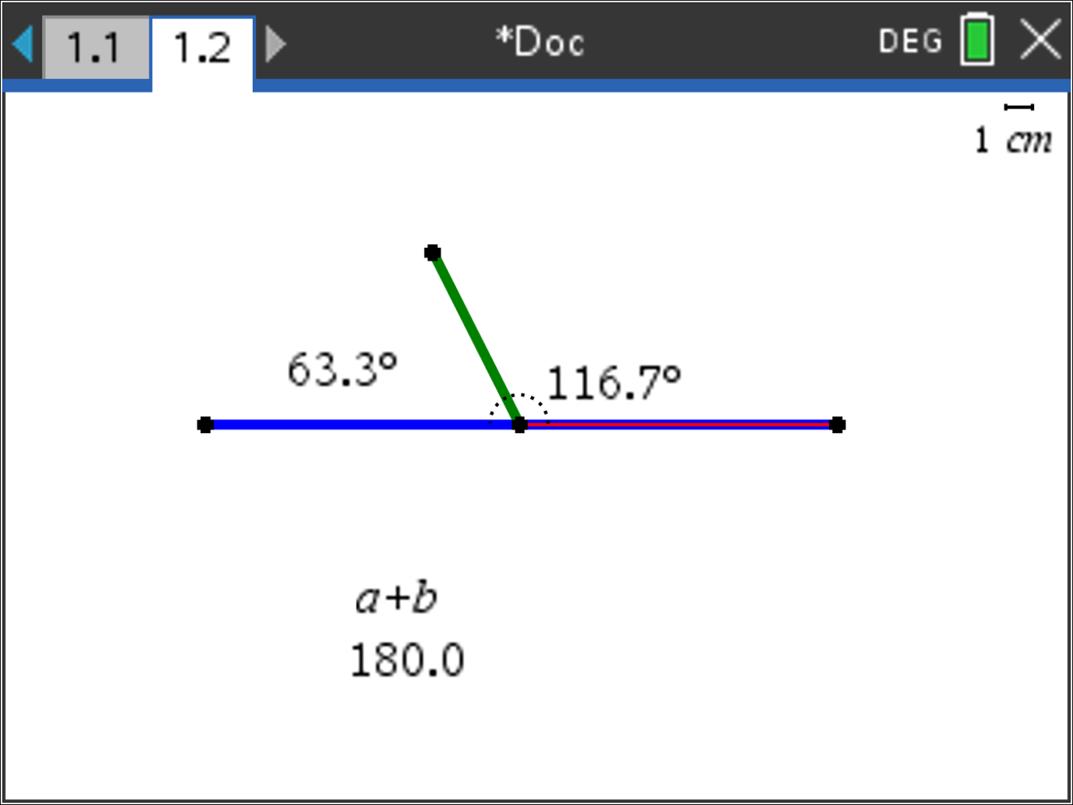
Quick Math Reminders
Complementary Angles:
Sum to 90 degrees
Supplementary Angles:
Sum to 180 degrees

Slide 21
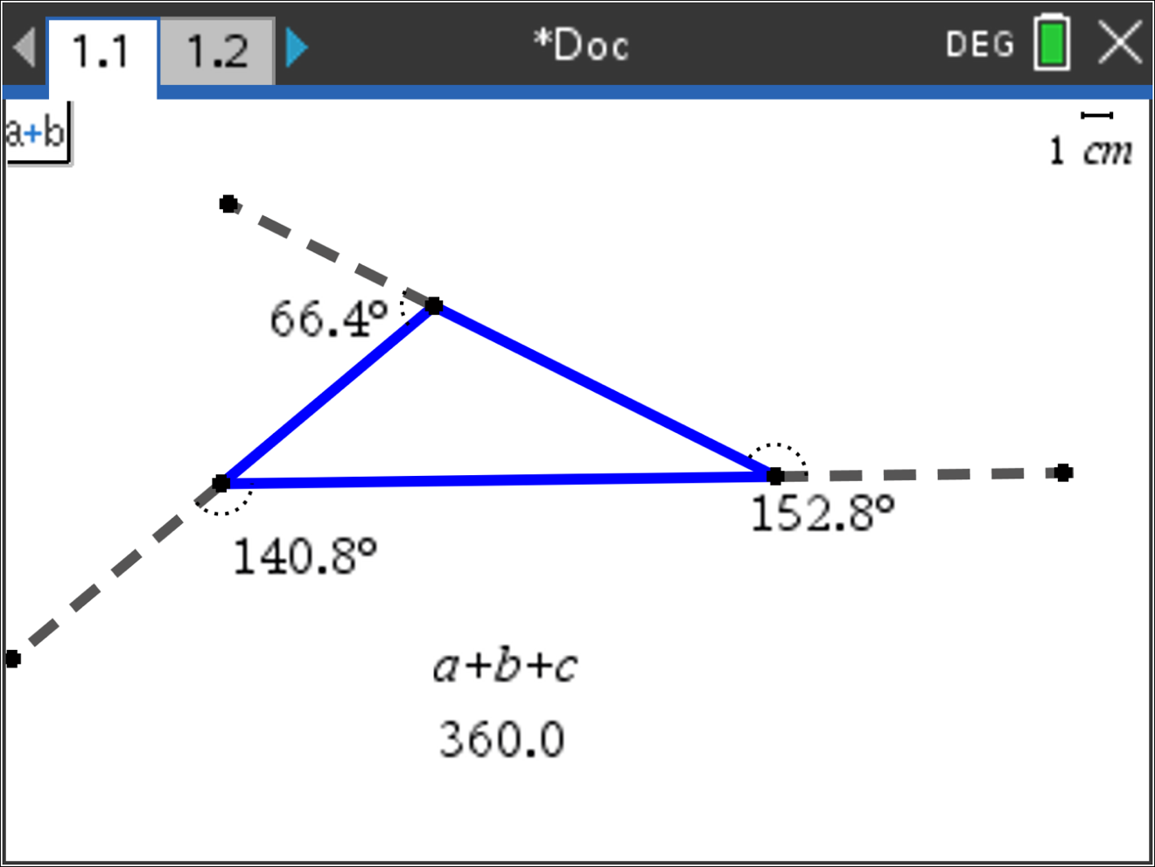
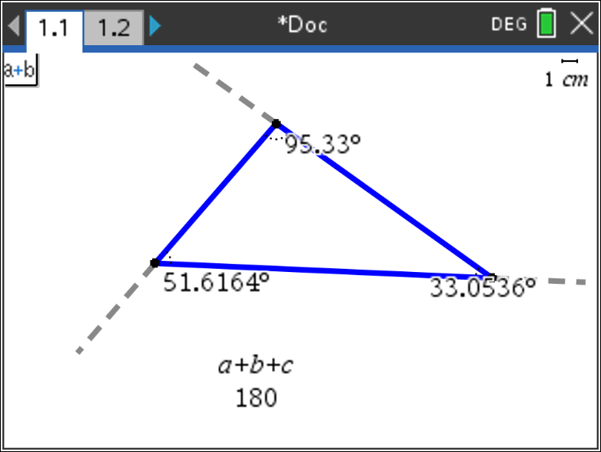
Quick Math Reminders
Exterior angles:
Interior Angles:

Slide 22
Logic Challenge
Task: Drive the figure shown without crossing any lines or going back over a line and without picking up the pen.
When you are ready put the pen in and trace your path
Notes:
First challenge is to drive the shape without crossing any lines and without picking up the pen.

Slide 23
Where can you go next with TI-Rover?
Drive an obstacle course
Drive a design
Draw artwork
Use a For loop
to draw polygons
Write your name
Navigate a map
Park your Rover

Slide 24
Quick Math Reminders
Pythagorean Theorem

Slide 25
Logic Challenge 2
Task: Drive the figure shown without crossing any lines or going back over a line and without picking up the pen.
When you are ready put the pen in and trace your path
Notes:
First challenge is to drive the shape without crossing any lines and without picking up the pen.
Second will be to drive at least one segment in reverse direction.

Slide 26
Logic Challenge 2
3
2
4
5
6
1
7
9
8
10
Notes:
First challenge is to drive the shape without crossing any lines and without picking up the pen.
Second will be to drive at least one segment in reverse direction.

Slide 27
Thank you!
See www.TIstemProjects.com for more TI STEM and coding activities and projects.

