Slide 1
Welcome to
Education Technology
Stephan Griebel, Business Development and Alliances

Slide 2
Agenda
When? | What? | Where?
8.30 | Arrival | VISS
9.15 | Welcome & Intro | Gate 1 Theater
10.30 | Break | Lobby
10.45 | Workshop | Classrooms
12.30 | Lunch | Lobby
13.30 | Workshop | Classrooms
15.00 | Break | Lobby
15.15 | Wrap-up | Gate 1 Theater
16.00 | End

Slide 3
Trainers and support staff
T³ Instructors
Mehdat Merabi, Bayan School, Bahrain
Paul Pinzone, VISS, UAE
Dr. Jason Johnson, Zayed University, UAE
Dr. Osama Rashwan, Ajman University, UAE
Texas Instruments
Stephan Griebel, Germany
BinHendi
Omer Sarsar, UAE
Soloman Edward, UAE

Slide 4
Who is Texas Instruments?

Slide 5
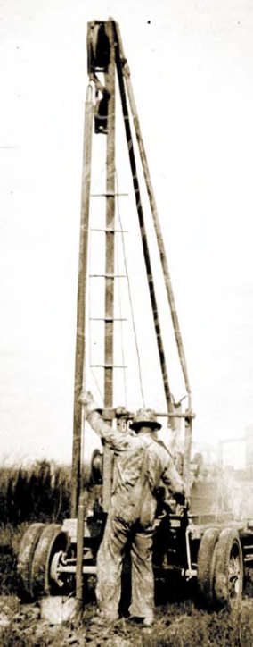
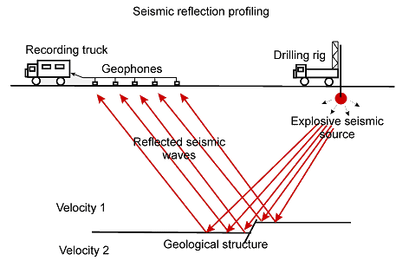
It all started with oil…
1930: Foundation as Geophysical Systems Inc (GSI)
1951: Name changed to General Instruments Inc.
1952: Name changed to Texas Instruments Inc. (TI)

Slide 6
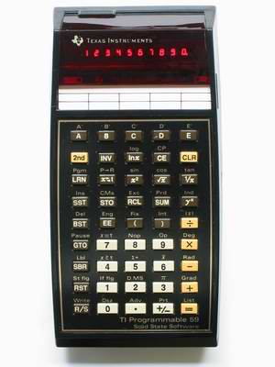
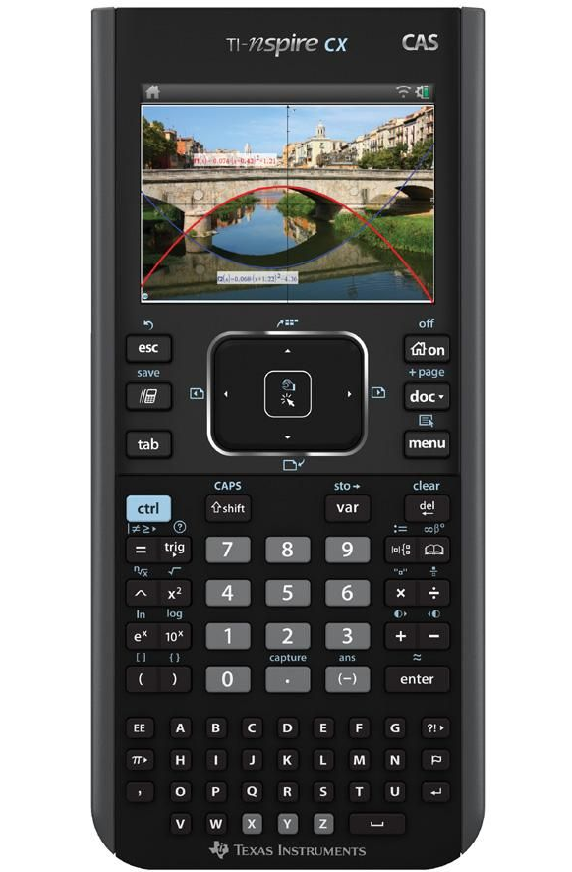
What do you know about Texas Instruments?
We are the Inventor of the electronic calculator…
… but also …

Slide 7
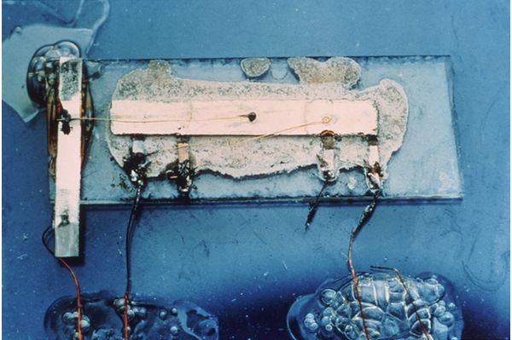
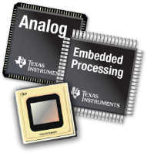
…an Innovation Leader with a long history!
Driving innovation for over 85 years.
Nobel Price in Physics,
awarded 2000
1930s
Revolutionizes oil exploration by measuring reflected signals
1950s
Invents the
integrated
Circuit
1970s
Applies signal
processing to
consumer
Products
1990s
Creates first apps
processor for
multi-media cell
phones
2010s
Introduced Kilby Labs Innovation Center
1940s
Applies signal
measurement
to magnetic
anomaly
detection
1960s
Invents the
handheld
calculator
1980s
Introduces
single-chip
digital signal
processor
2000s
Focus on innovation in Analog & Embedded Processing

Slide 8
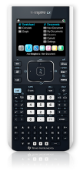
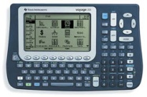
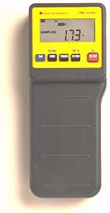
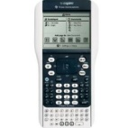
Graphing technology classroom success
Created with educators the graphing calculator for education:
100,000 users in 1990, 3+ million new users in 2000
~4 million new users every year since 2008, 2009 …
>> 24 million students use a TI educational product every day
1990
TI-81
2013
Nspired Learning
TI-Presenter
TI InterActive!
TI-Navigator
TI Data Collection
TI Viewscreen

Slide 9
Classroom Success
Motivated teachers
Thought-out curriculum and exam
Practical professional development
Hands-on educational materials
Versatile technology

Slide 10
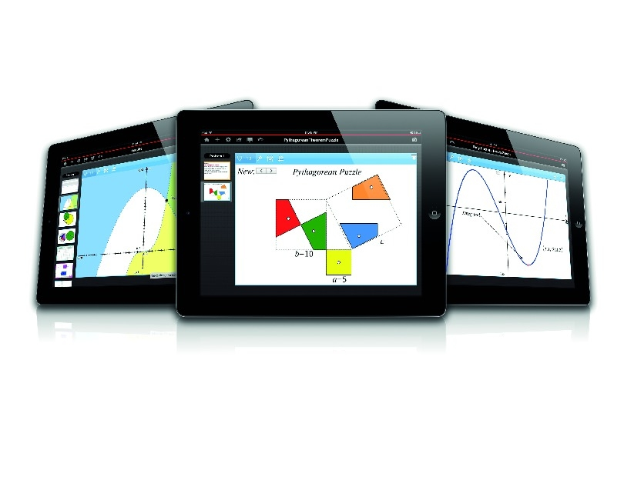
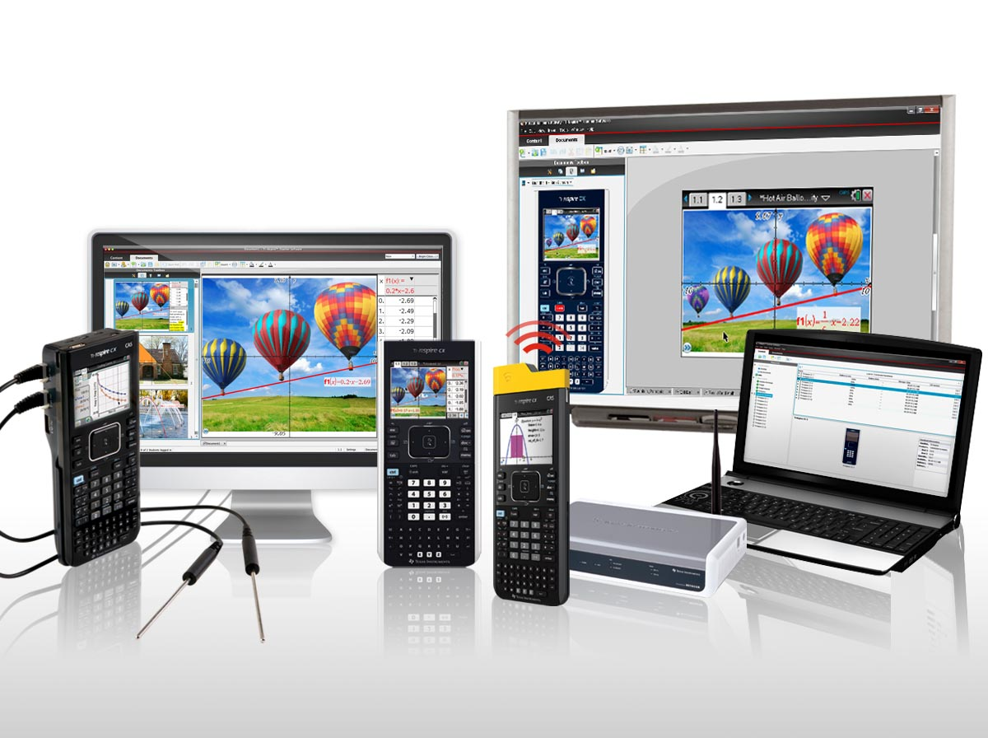
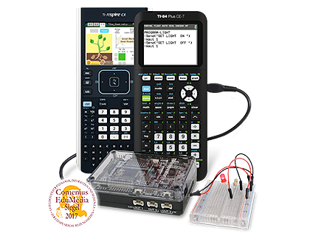
TI-Nspire Plattform

Slide 11
Who is T³?

Slide 12
Who is T³?
T³ = T cubed
T³ = Teachers Teaching with Technology
T³ = worldwide network of enthusiastic educators
Experienced by working with TI technology in the classroom
Community of like-minded practioners
Excited to share with colleagues nationally and internationally
Providing PD in various formats
Developing teacher and classroom content
Consulting policy makers for curriculum and exam developments

Slide 13
T³ Europe website
http://t3europe.eu

Slide 14
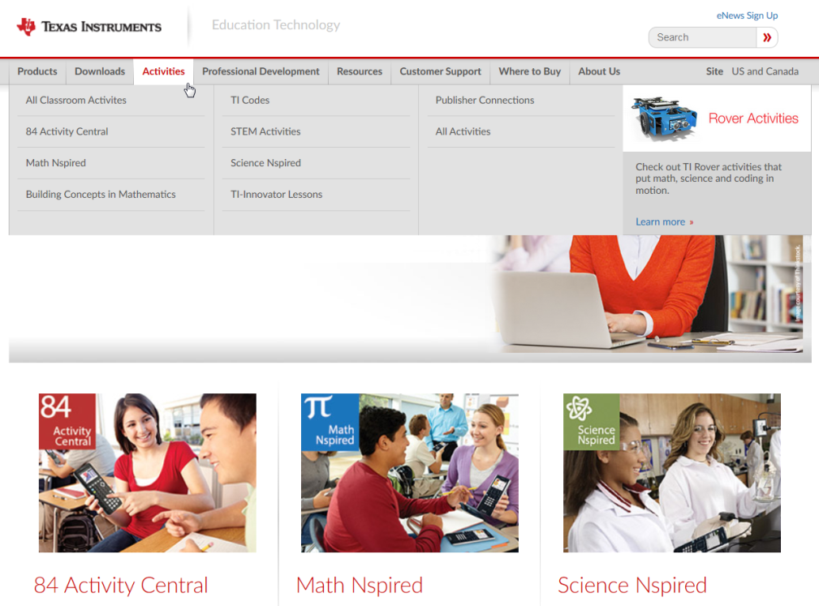
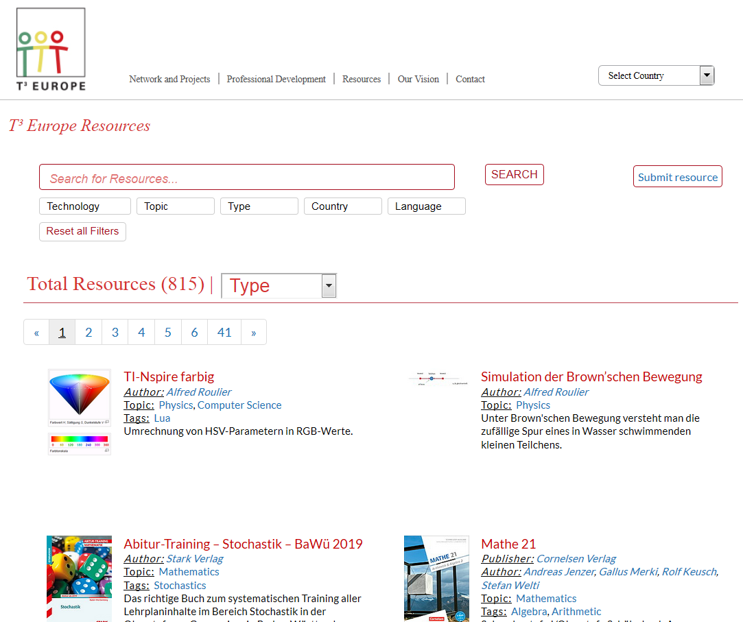
Teacher Content Resources
http://resources.t3europe.eu
https://education.ti.com/en/activities
Tutorial videos on Youtube
https://www.youtube.com/user/TexasInstrumentsCalc

Slide 15
T³ Middle East
Mehdat Merabi medhato2002@gmail.com
Paul Pinzone pinzone.paul@viss.ae
Dr. Jason Johnson jason.johnson@zu.ac.ae
Dr. Osama Rashwan fjac.ajami.o@ajman.ac.ae
Administration and support
Soloman Edward S.Edward@binhendi.com
Stephan Griebel s-griebel@ti.com

Slide 16
Workshops

Slide 17
Workshops
2x new users
1x Paul & Omer => classroom SG12
1x Jason & Osama => theater
1x current users
1x Stephan & Soloman => classroom SG18

Slide 18
Other useful Information…

Slide 19
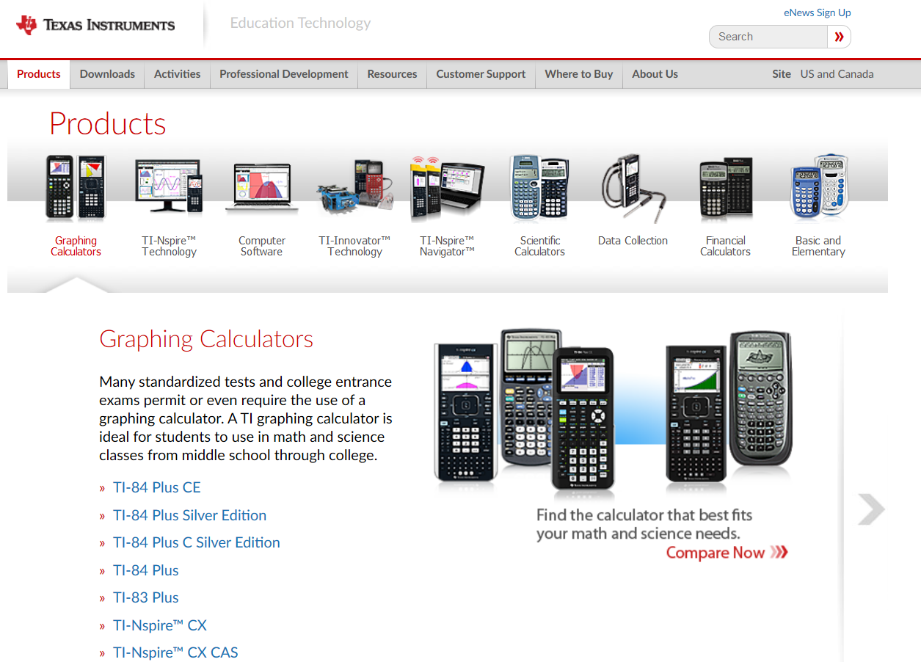
Product Information
TI website: https://education.ti.com/en/products

Slide 20
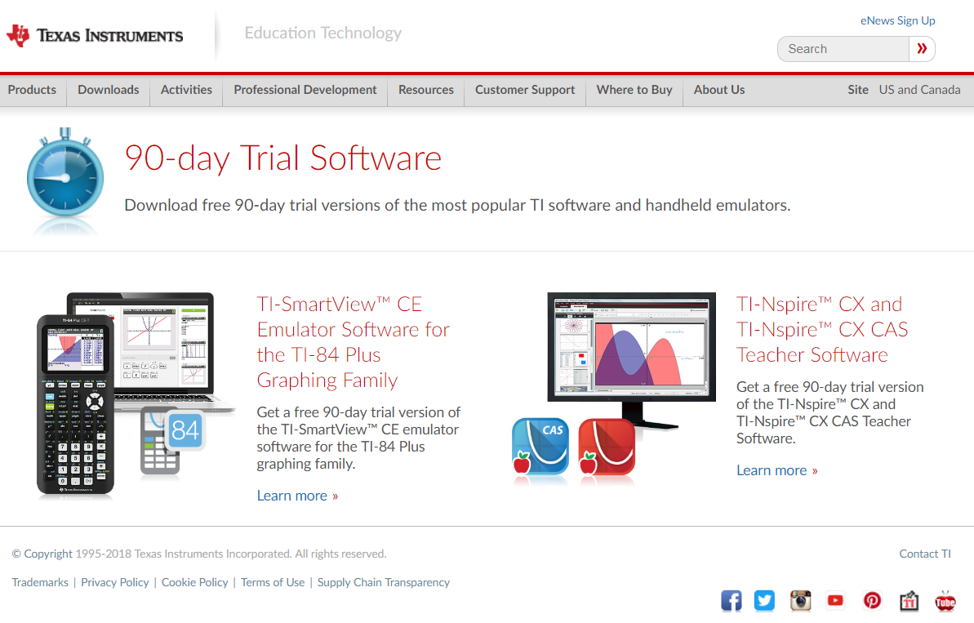
90-day Trial of TI-Nspire CX Teacher Software
Register and download from https://education.ti.com/en/downloads/trial-software

Slide 21
Technical questions & Lost License Keys
Texas Instruments Customer Service Center
Phone: 00 800-4 84 22 73 7
Fax: 00 420-2 26 22 17 99 Contact form: http://education.ti.com/csc

Slide 22
Distribution in UAE
School orders, customer service, warranty exchange, etc.
Soloman Edward
S.Edward@binhendi.com
+971 (55) 4475 485

